Slide 1
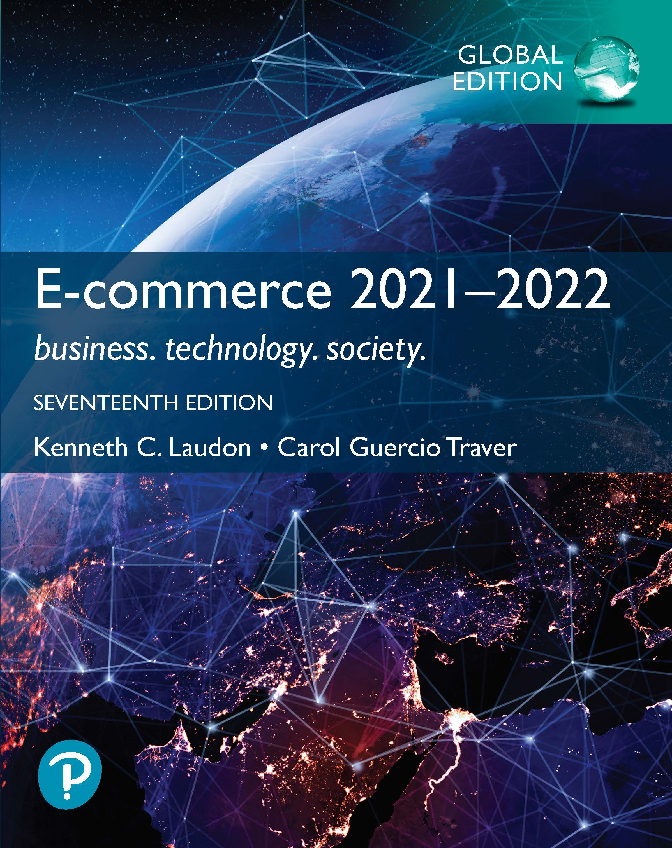
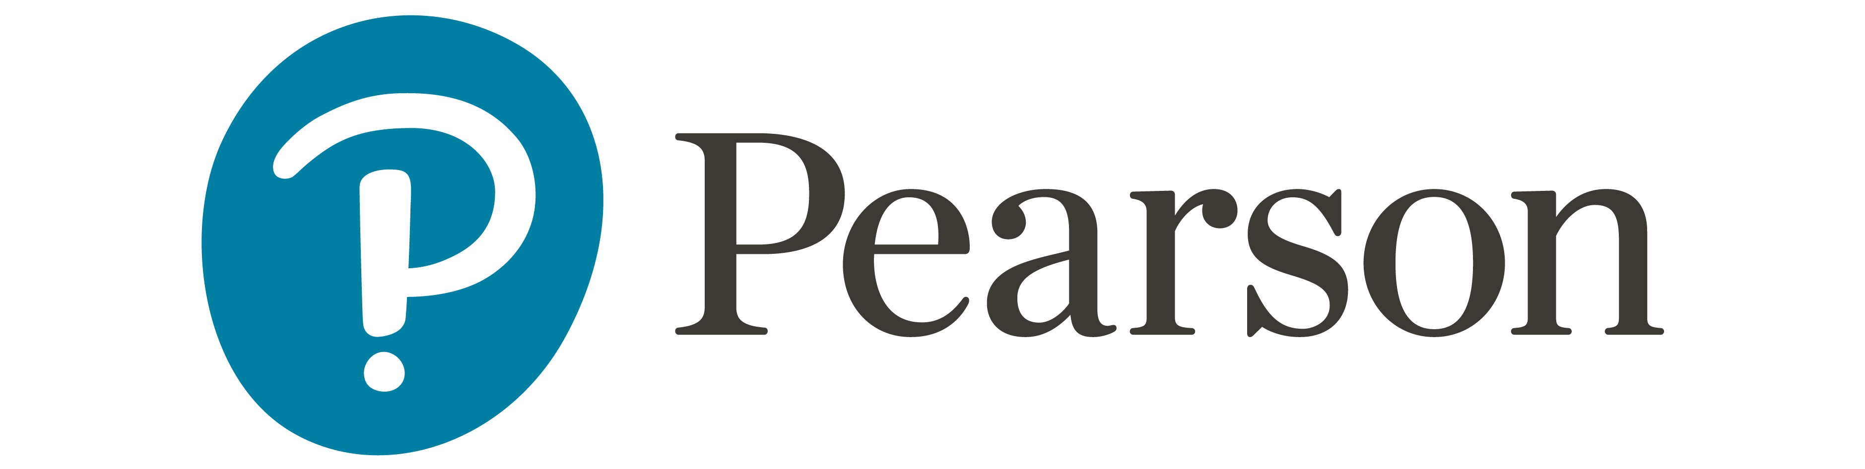
E-commerce 2021–2022: Business. Technology. Society.
Seventeenth Edition, Global Edition
Chapter 5
E-commerce Security
Copyright © 2022, 2019, 2018 Pearson Education, Ltd. All Rights Reserved
Notes:
If this PowerPoint presentation contains mathematical equations, you may need to check that your computer has the following installed:
1) MathType Plugin
2) Math Player (free versions available)
3) NVDA Reader (free versions available)

Slide 2
Learning Objectives
5.1 Understand the scope of e-commerce crime and security problems, the key dimensions of e-commerce security, and the tension between security and other values.
5.2 Identify the key security threats in the e-commerce environment.
5.3 Describe how technology helps secure Internet communications channels and protect networks, servers, and clients.
5.4 Appreciate the importance of policies, procedures, and laws in creating security.

Slide 3
Ransomware: The New Business of Hostage-taking
Class Discussion
  How do cybercriminals use phishing in ransomware attacks?
  Why have ransomware attacks escalated recently?
  What damage can be done by ransomware attacks?
  What steps should be taken to avoid ransomware attacks?

Slide 4
The E-Commerce Security Environment

Slide 5
Scope of the Problem
Overall size of and losses due to cybercrime unclear
  Center for Strategic and International Studies study: Global economic impact of cybercrime and cyberespionage more than $1 trillion; other researchers believe the amount is even higher
  IBM Security/Ponemon Institute 2021 Cost of Data Breach Report: total average cost of a data breach globally was $4.2 million
Underground economy marketplaces sell stolen information, malware and more

Slide 6
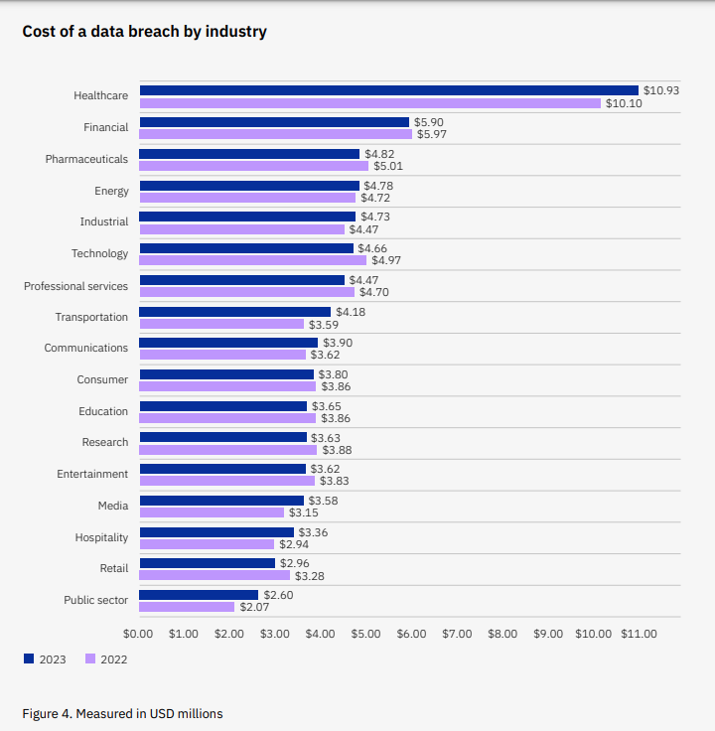
Cost of a data breach by industry
IBM Cost of a Data Breach Report 2023

Slide 7
Dark web prices 2023 for stolen data
This is a sample of prices for stolen financial and social media data from 2021 and 2023
Category | Product | 2021 | 2023
Credit Card & Banking | Cloned Mastercard with PIN | $25 | $20
 | Cloned American Express with PIN | $35 | $20
 | Cloned VISA with PIN | $25 | $20
 | Credit card details, account balance up to $1000 | $150 | $70
 | Credit card details, account balance up to $5000 | $240 | $110
 | Stolen online banking logins, minimum $100 on account | $40 | $40
 | Stolen online banking logins, minimum $2000 on account | $120 | $60
 | Walmart account with credit card attached | $14 | $5
Payment Processing Services | Stolen PayPal account details, minimum $100 - $1000 | $30 | $25
 | PayPal transfer from stolen account, $1000 – $3000 | $340 | $30
 | PayPal transfers from stolen account, $3000+ | $180 | $180
 | Western Union transfer from stolen account > $1000 | $45 | $10
Social Media | Hacked Facebook account | $65 | $25
 | Hacked Instagram account | $45 | $25
 | Hacked Twitter account | $35 | $20
 | Hacked Gmail account | $80 | $60
Crypto Accounts | N26 verified account (Germany) |  | $2,650
Table: The Conversation, CC-BY-ND Source: PrivacyAffairs.com

Slide 8
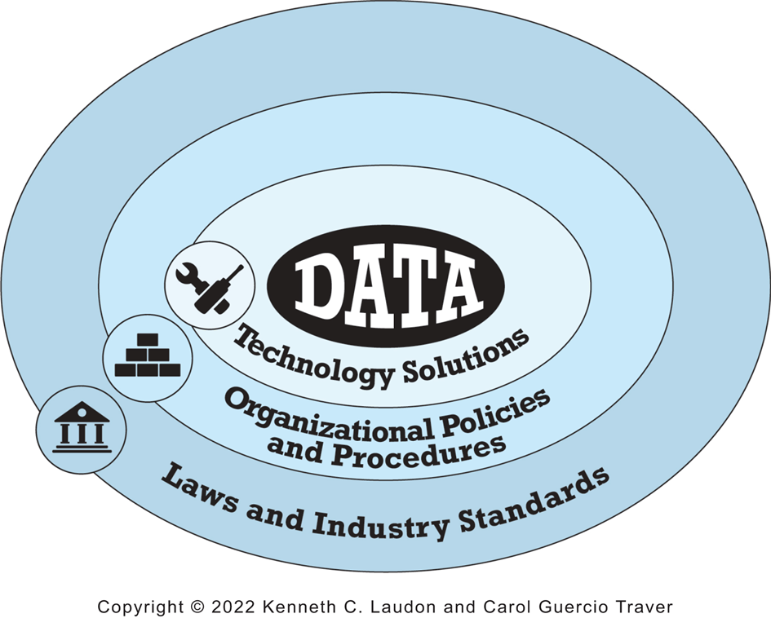
What Is Good E-commerce Security?
To achieve highest degree of security
  New technologies
  Organizational policies and procedures
  Industry standards and government laws
Other factors
  Time value of money
  Cost of security versus potential loss
  Security often breaks at weakest link
Figure 5.1 The E-commerce Security Environment

Slide 9
Customer and Merchant Perspectives on the Different Dimensions of E-commerce Security
Dimension | Customer’s Perspective | Merchant’s Perspective
Integrity | Has information I transmitted or received been altered? | Has data on the site been altered without authorization? Is data being received from customers valid?
Nonrepudiation | Can a party to an action with me later deny taking the action? | Can a customer deny ordering products?
Authenticity | Who am I dealing with? How can I be assured that the person or entity is who they claim to be? | What is the real identity of the customer?
Confidentiality | Can someone other than the intended recipient read my messages? | Are messages or confidential data accessible to anyone other than those authorized to view them?
Privacy | Can I control the use of information about myself transmitted to an e-commerce merchant? | What use, if any, can be made of personal data collected as part of an e-commerce transaction? Is the personal information of customers being used in an unauthorized manner?
Availability | Can I get access to the site? | Is the site operational?
Table 5.3

Slide 10
The Tension Between Security and Other Values
Security is not an unmitigated good.
Tensions between security and ease of use
  The more security measures added, the more difficult a site is to use, and the slower it becomes
  Too much security can harm profitability; not enough can put a business out of business
Possible solution: adaptive approach to security
  Segment users by risk profile
  Adjust security settings to users’ preferences

Slide 11
Most Common Security Threats

Slide 12
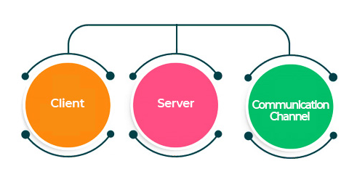
Security Threats in the E-commerce Environment
Three key points of vulnerability in
e-commerce environment
Internet Communications Channels

Slide 13
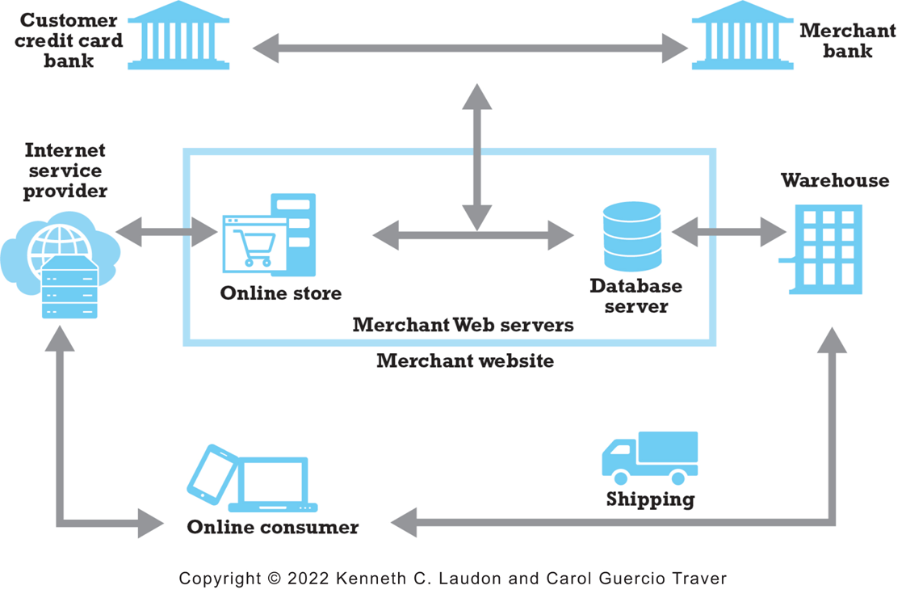
Figure 5.2: A Typical E-Commerce
Transaction
Notes:
Figure 5.2, Page 264.
In a typical e-commerce transaction, the customer uses a credit card and the existing credit payment system.
Alt Text
Long description: An illustration provides an overview of a typical e commerce transaction, as follows: In a typical e commerce transaction, an online consumer accesses the online store through an internet service provider. The web servers at the online store connect to its database server to collect and shares information with the customer’s credit card bank and the merchant’s bank. The order is shared with the warehouse, which arranges for shipping to the online consumer.

Slide 14
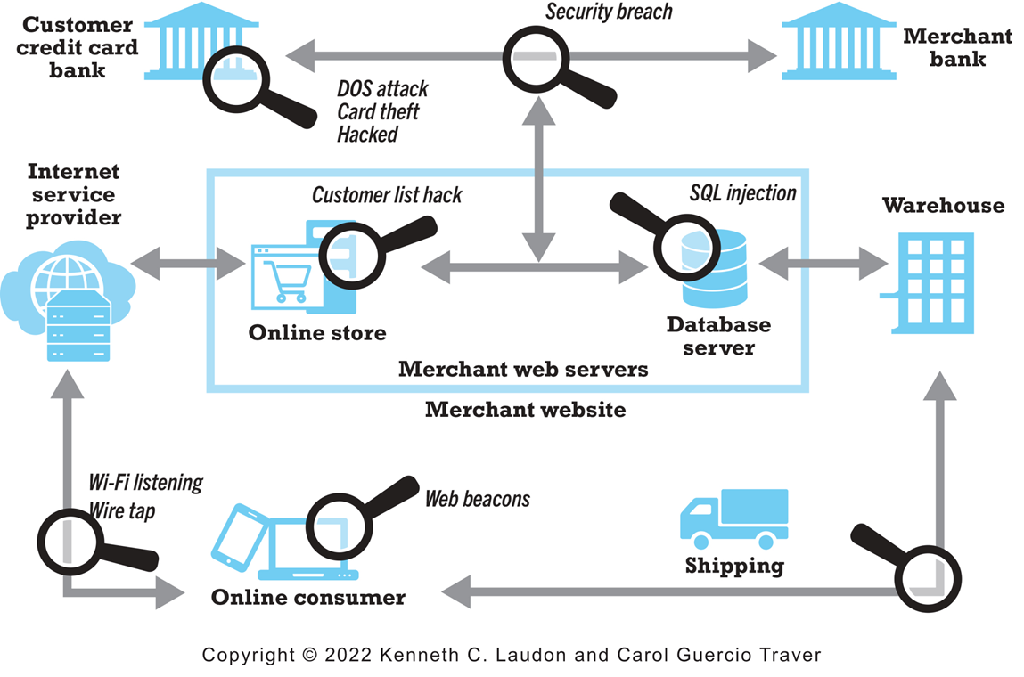
Figure 5.3 Vulnerable Points in an
E-Commerce Transaction
Notes:
Figure 5.3, Page 265.
There are three major vulnerable points in e-commerce transactions: Internet communications, servers, and clients.
Alt Text
Long description: An illustration depicts the vulnerable points in a typical e commerce transaction, as follows: The online consumer computer is vulnerable to web beacons. The connection between the online consumer and internet service provider is vulnerable to WI FI listening and wire taps. The online store is vulnerable to a customer list hack. The database server is vulnerable to an S Q L injection attack. The customer credit card bank is vulnerable to a DOS attack, card theft, or other hack. The connection between the customer credit card bank and the merchant bank is vulnerable to a security breach that also impact the online store.

Slide 15
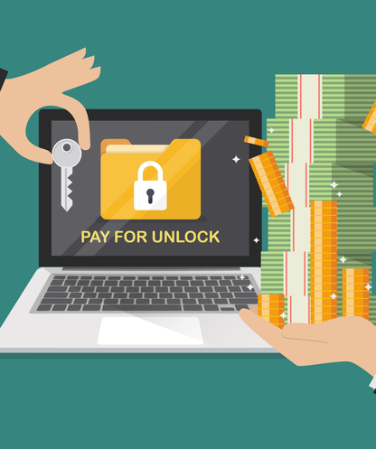
Malicious Code
Exploits and exploit kits
Malvertising
Drive-by downloads
Viruses
Worms
Ransomware
Trojan horses
Backdoors
Bots and botnets

Slide 16
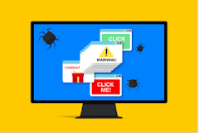
Potentially Unwanted Programs
Also referred to as:
Potentially Unwanted Applications
Browser parasites
  Monitor and change user’s browser
  Can be used for cryptojacking
Adware
  Used to call pop-up ads
Spyware
  Tracks users’ keystrokes, e-mails, IMs, etc.

Slide 17
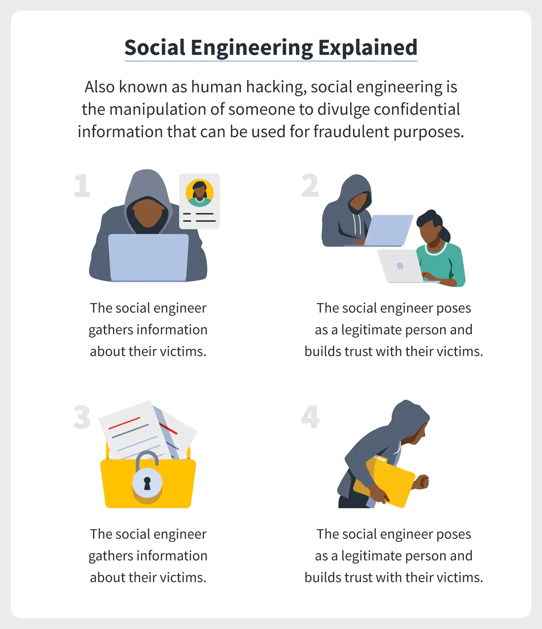
Phishing
Any deceptive, online attempt by a third party to obtain confidential information for financial gain
Tactics
  Social engineering
  E-mail scams and BEC phishing
  Spear phishing
Used for identity fraud and theft

Slide 18
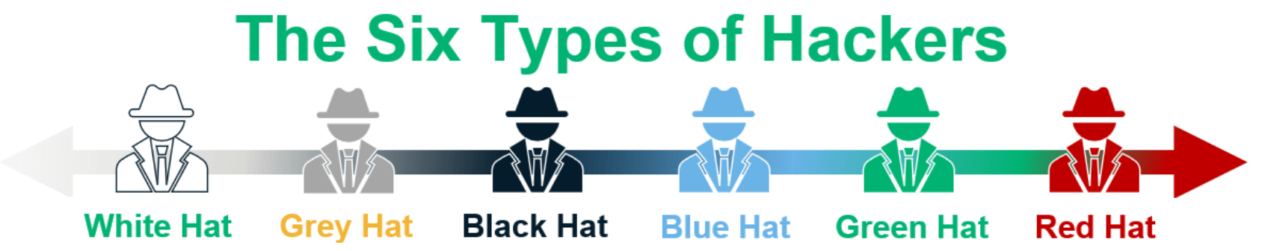
Hacking, Cybervandalism, and Hacktivism
Hacking
  Hackers versus crackers
  Types of Hackers: White hats, black hats, grey hats
  Goals: cybervandalism, data breaches
Cybervandalism:
  Disrupting, defacing, destroying Web site
Ethical hackers and bug bounty hunters
Hacktivism

Slide 19
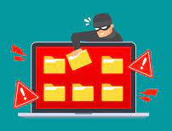
Data Breaches
Organization loses control over corporate information to outsiders
Enabler for credential stuffing attacks
  Brute force launched via botnets and automated tools
In Q3 2024, average of 1,876 cyber attacks per organization was recorded, marking a 75% increase compared to the same period in 2023 and a 15% rise from the previous quarter.
Leading causes
    Malicious code
    Human and system errors

Slide 20
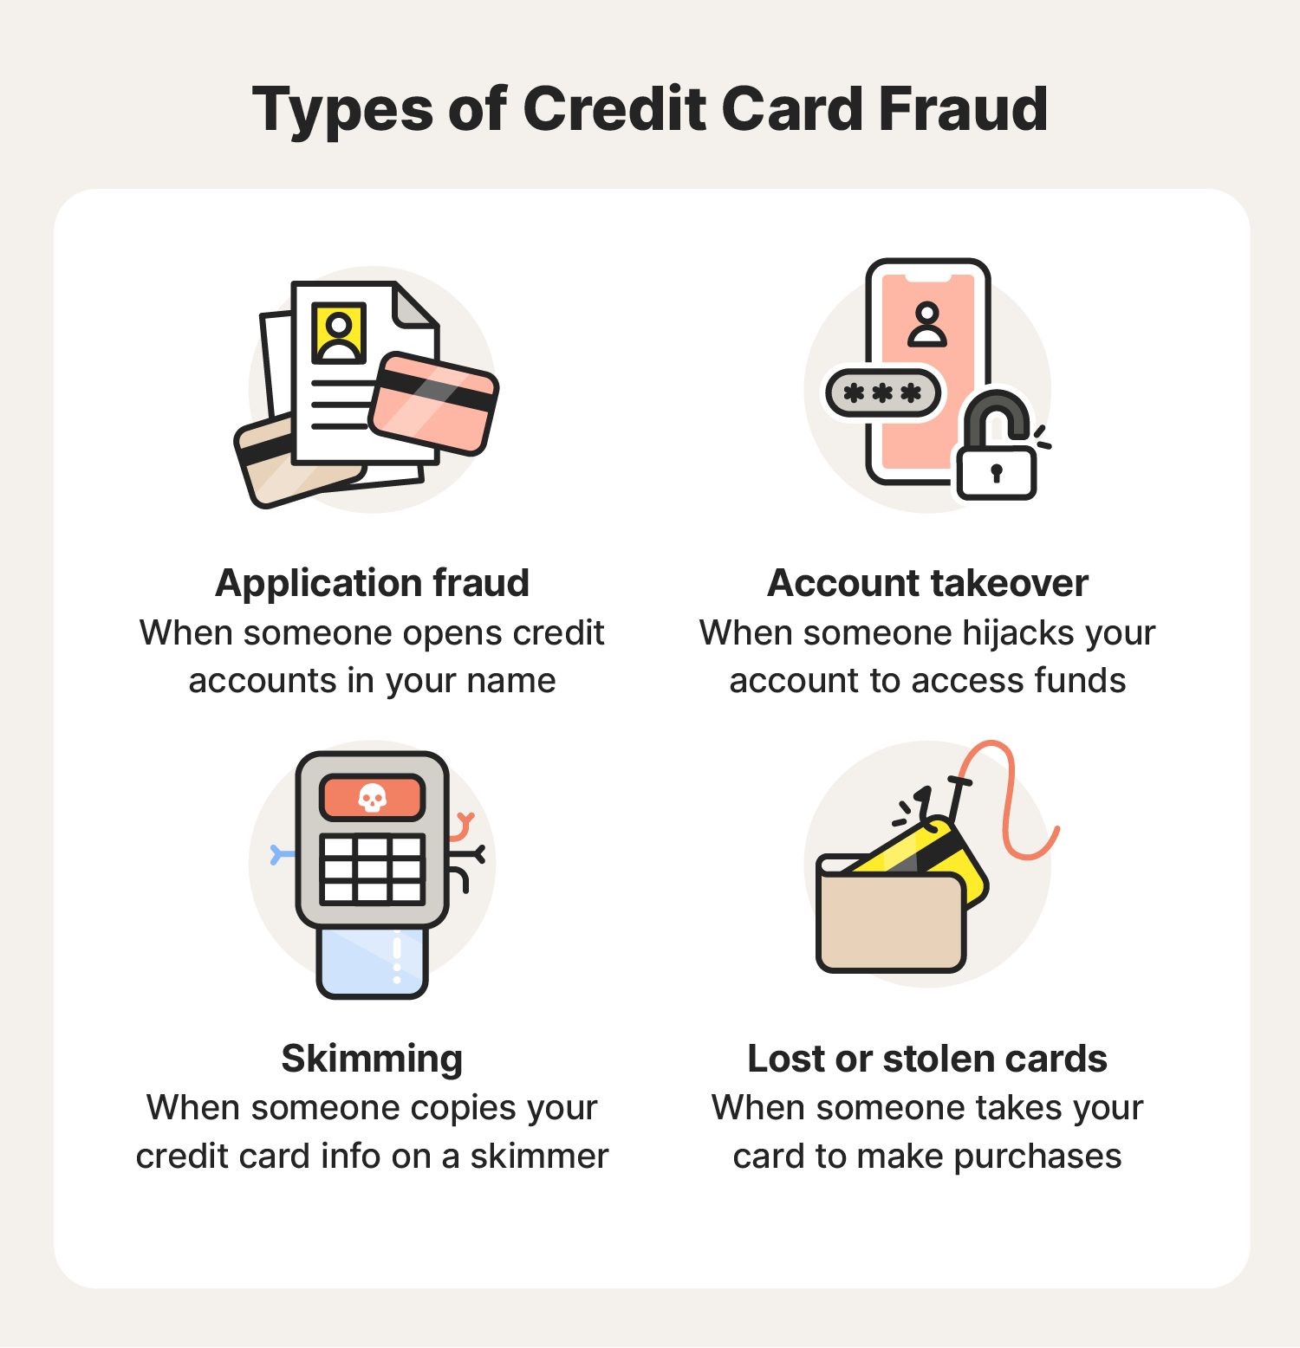
Credit Card Fraud/Theft
One of most feared occurrences
Stolen credit card incidences approx:
  0.9% on the Web
  0.8% of mobile transactions
In UK, > £570 million stolen by fraudsters in the first half of 2024
Systematic hacking and looting of corporate servers is primary cause

Slide 21
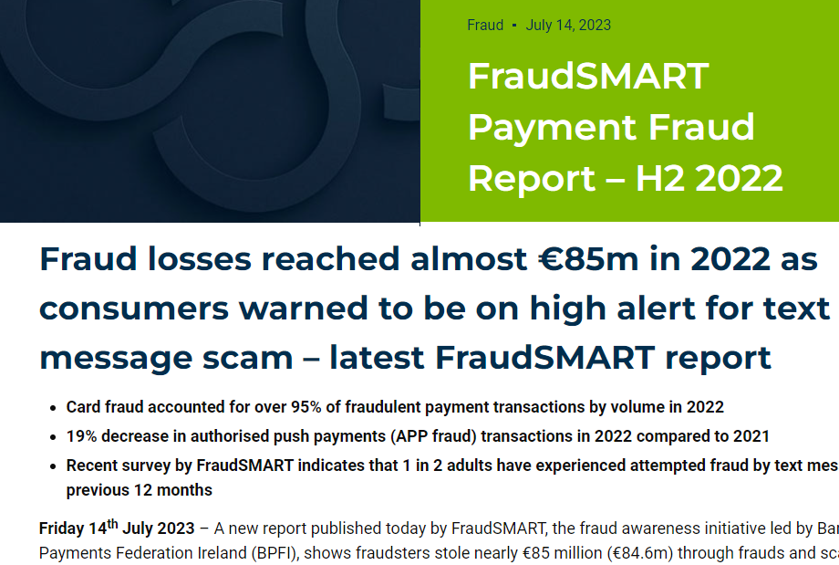
Identity Fraud/Theft
FraudSMART Payment Fraud Report – H2 2022
Identity theft is stealing another person’s identity.
Identity fraud occurs when the thief does things with the identity they stole.
Unauthorized use of another person’s personal data for illegal financial benefit
  PPS Number
  Driver’s license
  Credit card numbers
  Usernames/passwords

Slide 22
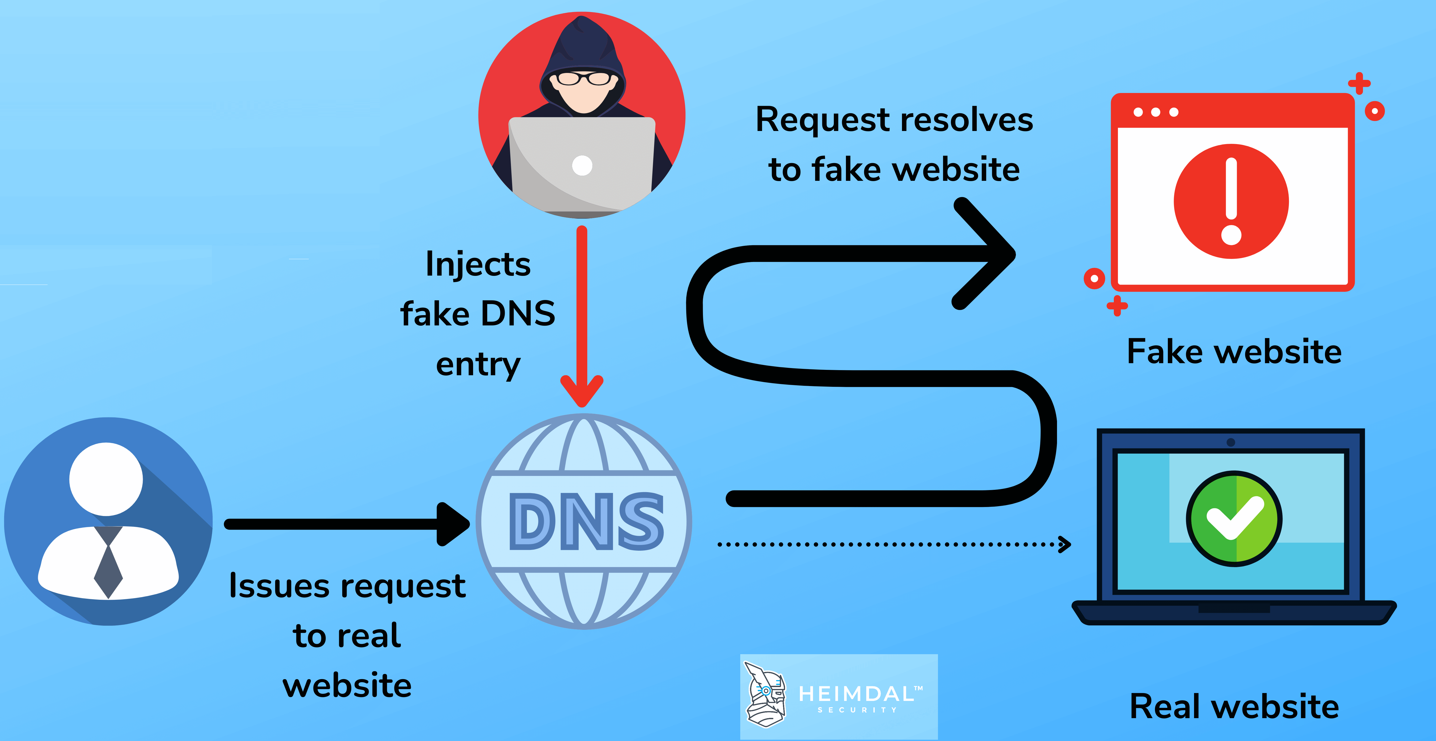
Spoofing, Pharming, and Spam Websites
Spoofing: attempting to hide one’s true identity by using someone else’s e-mail or IP address
Pharming: Automatically redirecting a URL to a different address, to benefit the hacker
Spam (junk) websites: Offer collection of advertisements for other sites, which may contain malicious code

Slide 23
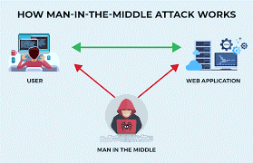
Sniffing and Man-in-The-Middle Attacks
Sniffer
  Eavesdropping program monitoring networks
  Can identify network trouble spots
  Can be used by criminals to steal proprietary information
Man-in-the-middle attack
  Attacker intercepts and changes communication between two parties who believe they are communicating directly

Slide 24
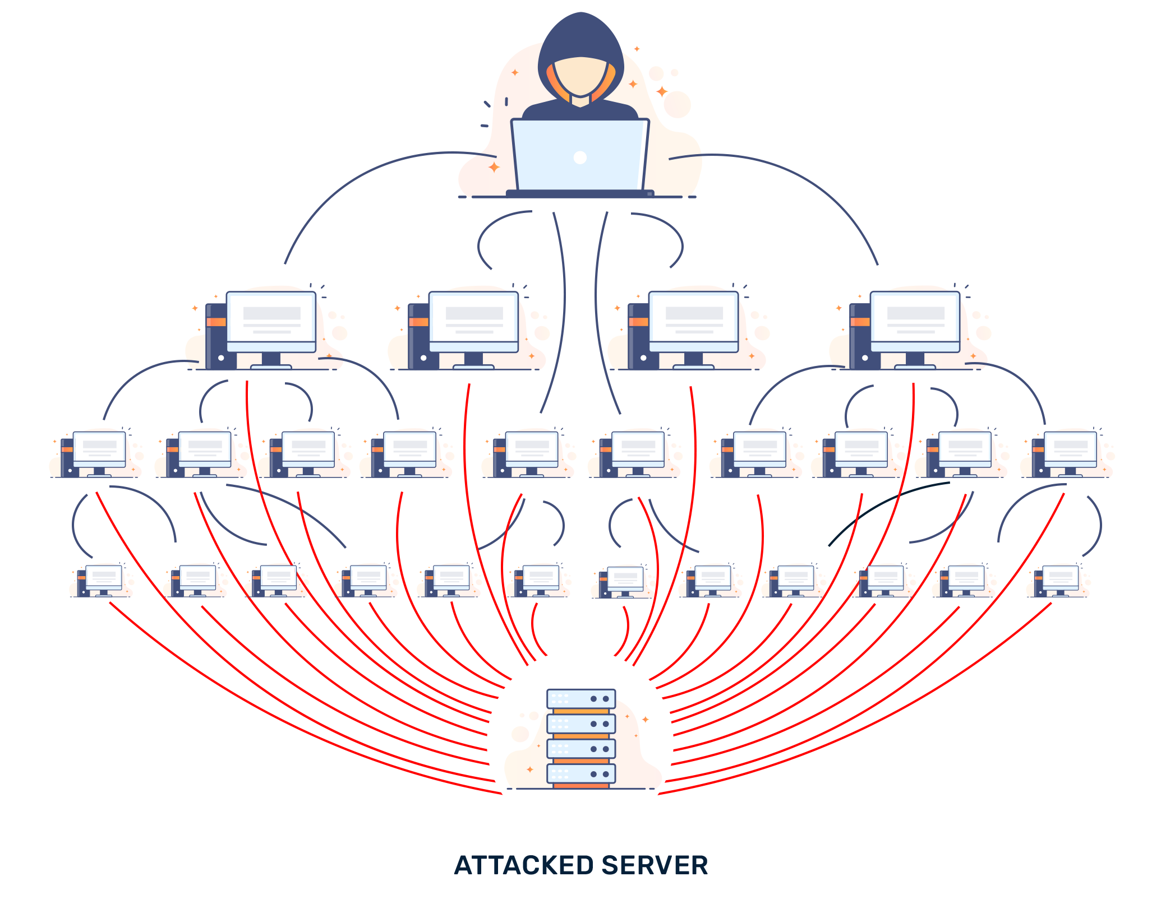
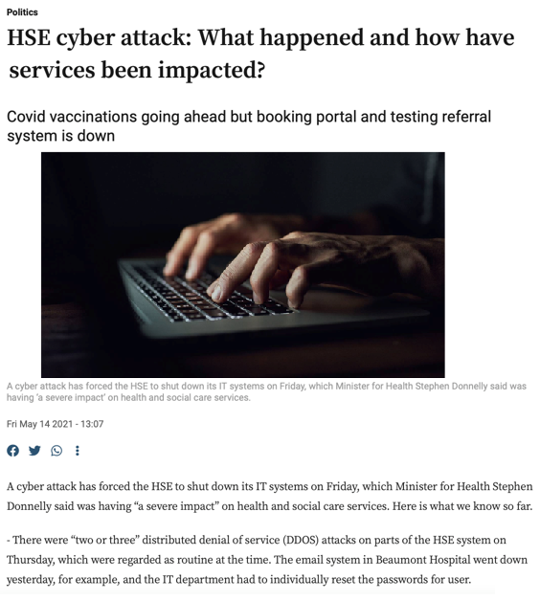
DoS and DDoS Attacks
Denial of service (DoS) attack
  These attacks flood a target's network or website with traffic, overwhelming it and causing it to become unavailable to users.
Distributed Denial of Service (DDoS) attack
  Uses hundreds or thousands of computers to attack target network
  DDoS smokescreening uses DDoS attack as a distraction to insert malware or viruses or to steal data

Slide 25
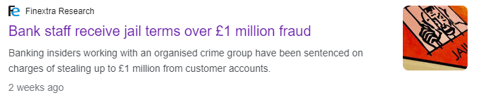
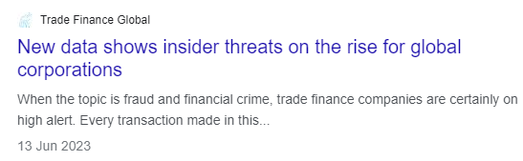
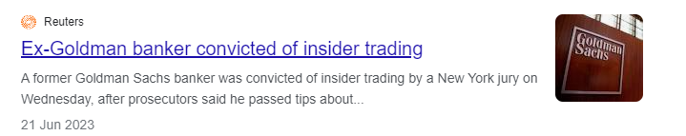
Insider Attacks
Biggest financial threat to businesses comes from insider embezzlement
Employee access to privileged information
Poor security procedures
Insiders more likely to be source of cyberattacks than outsiders

Slide 26
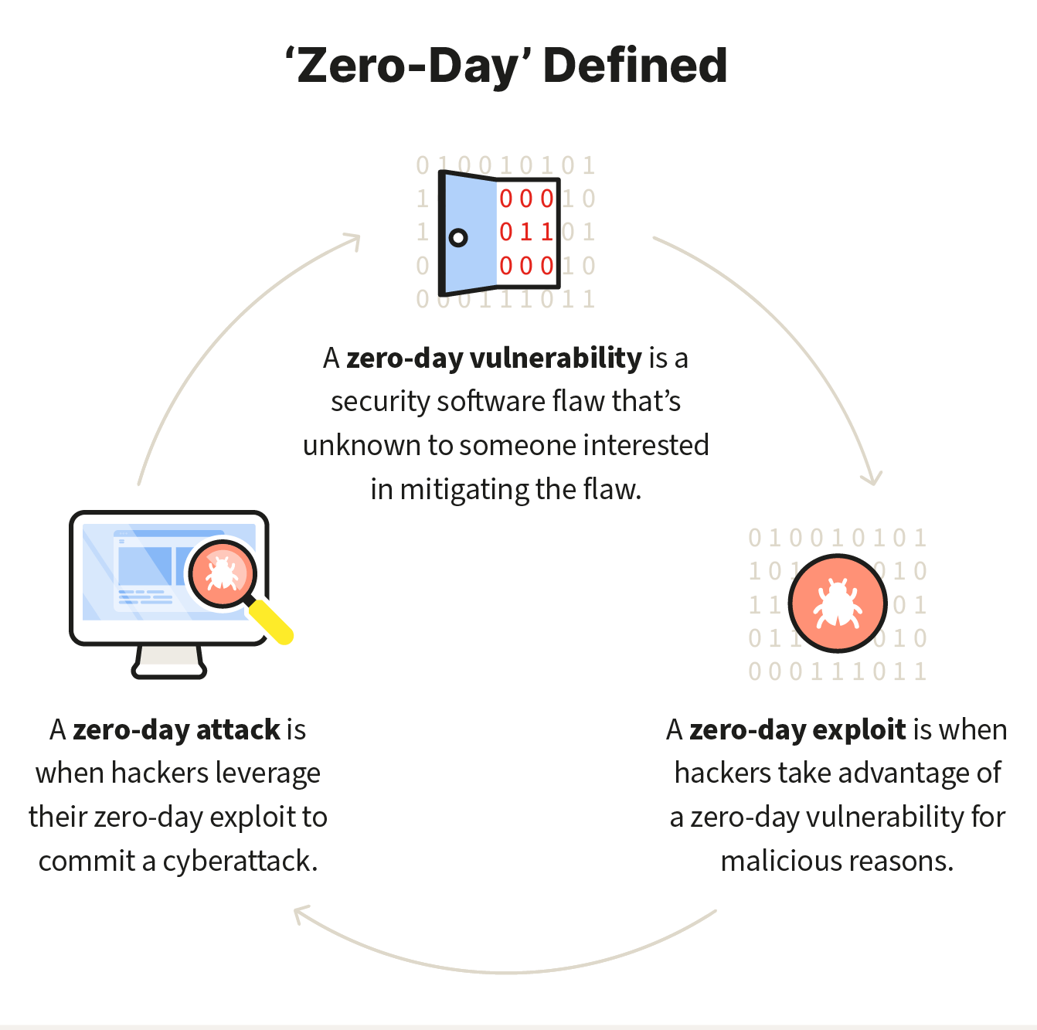
Poorly Designed Software
Increase in complexity of and demand for software has led to increase in flaws and vulnerabilities
SQL injection attacks
  Large number of web applications believed to be vulnerable to an SQL injection attack
Zero-day vulnerabilities
  Second biggest risk to endpoint security, just behind ransomware

Slide 27

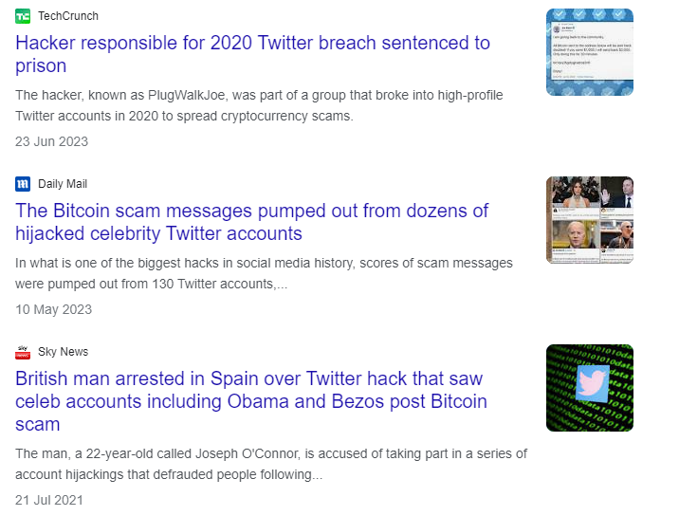
Social Network Security Issues
Social networks an environment for:
  Viruses, site takeovers, identity fraud, malware-loaded apps, click hijacking, phishing, spam
Manual sharing scams Sharing of files that link to malicious sites
Fake offerings, fake Like buttons, and fake apps
2020 Twitter hack used social engineering to take control of dozens of prominent accounts and post Bitcoin scam

Slide 28
Mobile Platform Security Issues
Mobile devices face same risks as any Internet-connected devices as well as some additional riskses
Threats include:
  Rogue apps
  Browser-based malware
  Smishing and SMS spoofing
Between 2021 and 2022, the number of critical vulnerabilities discovered on the Android operating system grew from 571 to 897.
Apple iOS platforms account for a significant majority–80%, of the zero-day vulnerabilities being exploited in the wild.
Zimperium: 2023 Global Mobile Threat Report June 28, 2023

Slide 29
Insight on Technology: Think Your Smartphone Is Secure?
Class Discussion
  What types of threats do smartphones face?
  Are there any vulnerabilities specific to mobile devices?
  What qualities of apps make them a vulnerable security point in smartphone use?
  Are apps more or less likely to be subject to threats than traditional P C software programs?

Slide 30
Mobile Threats
Malware: Viruses, spyware, trojans, and ransomware adapted for Android/iOS.
Phishing & Social Engineering: SMS (“smishing”), fake login screens, malicious QR codes.
Network Attacks: Data interception on unsecured Wi-Fi (man-in-the-middle attacks).
Theft & Physical Access: Lost or stolen devices exposing unencrypted data.
Tracking & Surveillance: GPS tracking, unauthorized microphone/camera use.
Exploits: Vulnerabilities in the OS, firmware, or apps exploited for privilege escalation.

Slide 31
Mobile Specific Threats
App Store Ecosystem: Even official stores sometimes fail to detect malicious apps. On Android, sideloading apps from third-party stores greatly increases risk.
Fragmentation: Many Android devices don’t receive timely OS/security updates, leaving older devices vulnerable.
Mobile Hardware Features: Sensors (GPS, accelerometer, camera, microphone) expand the attack surface. An app with excessive permissions can become a surveillance tool.
SIM Swap Attacks: Attackers trick mobile carriers into reassigning your phone number, hijacking SMS-based authentication.

Slide 32
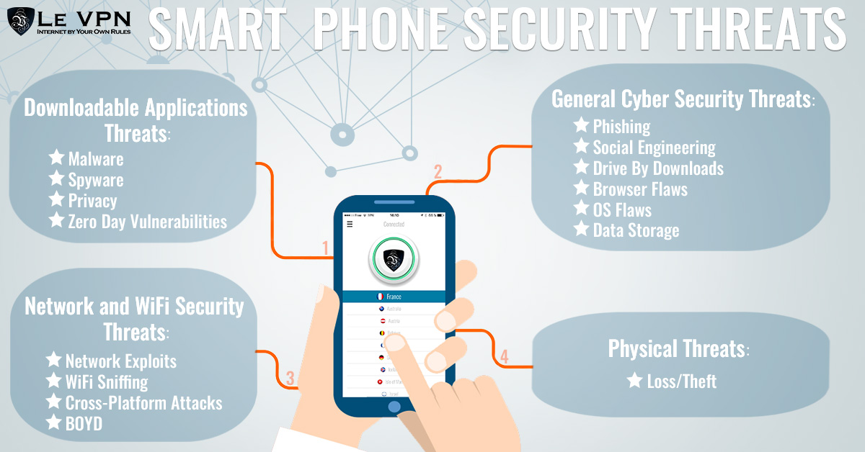
Bluetooth & NFC Exploits: These short-range technologies can be abused for attacks in public spaces.

Slide 33
Mobile Specific Vulnerabilities
Excessive Permissions: Apps that request unnecessary access (e.g., flashlight apps asking for contact list).
Poor Coding Practices: Lack of input validation, weak encryption, insecure APIs.
Unverified Sources: Apps downloaded from unofficial marketplaces may be trojans in disguise.
Embedded Advertising SDKs: Third-party code for ads/analytics often leaks data or contains vulnerabilities.
Weak Update Practices: Apps that aren’t updated regularly may have unpatched vulnerabilities.

Slide 34
Are apps more or less likely to be subject to threats than traditional PC software programs?
More Secure in Some Ways:
Apps are usually sandboxed (isolated from each other and the OS).
Installation is streamlined through app stores with some vetting.
Mobile OSs are designed with strong permissions models from the ground up.
More Vulnerable in Other Ways:
Huge reliance on apps means wider attack surface (many apps = many opportunities).
Mobile devices are rarely protected by antivirus/firewall tools that are common on PCs.
User behavior (downloading apps casually, granting permissions quickly) is a weak link.

Slide 35
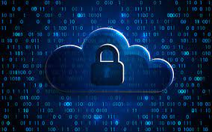
Cloud Security Issues
DDoS attacks
Safeguarding data maintained in a public cloud a major concern
Infrastructure scanning
Lower-tech phishing attacks yield passwords and access
Use of cloud storage to connect linked accounts
  Most organizations don’t take full responsibility for the security of their data in the cloud
Lack of encryption and strong security procedures

Slide 36
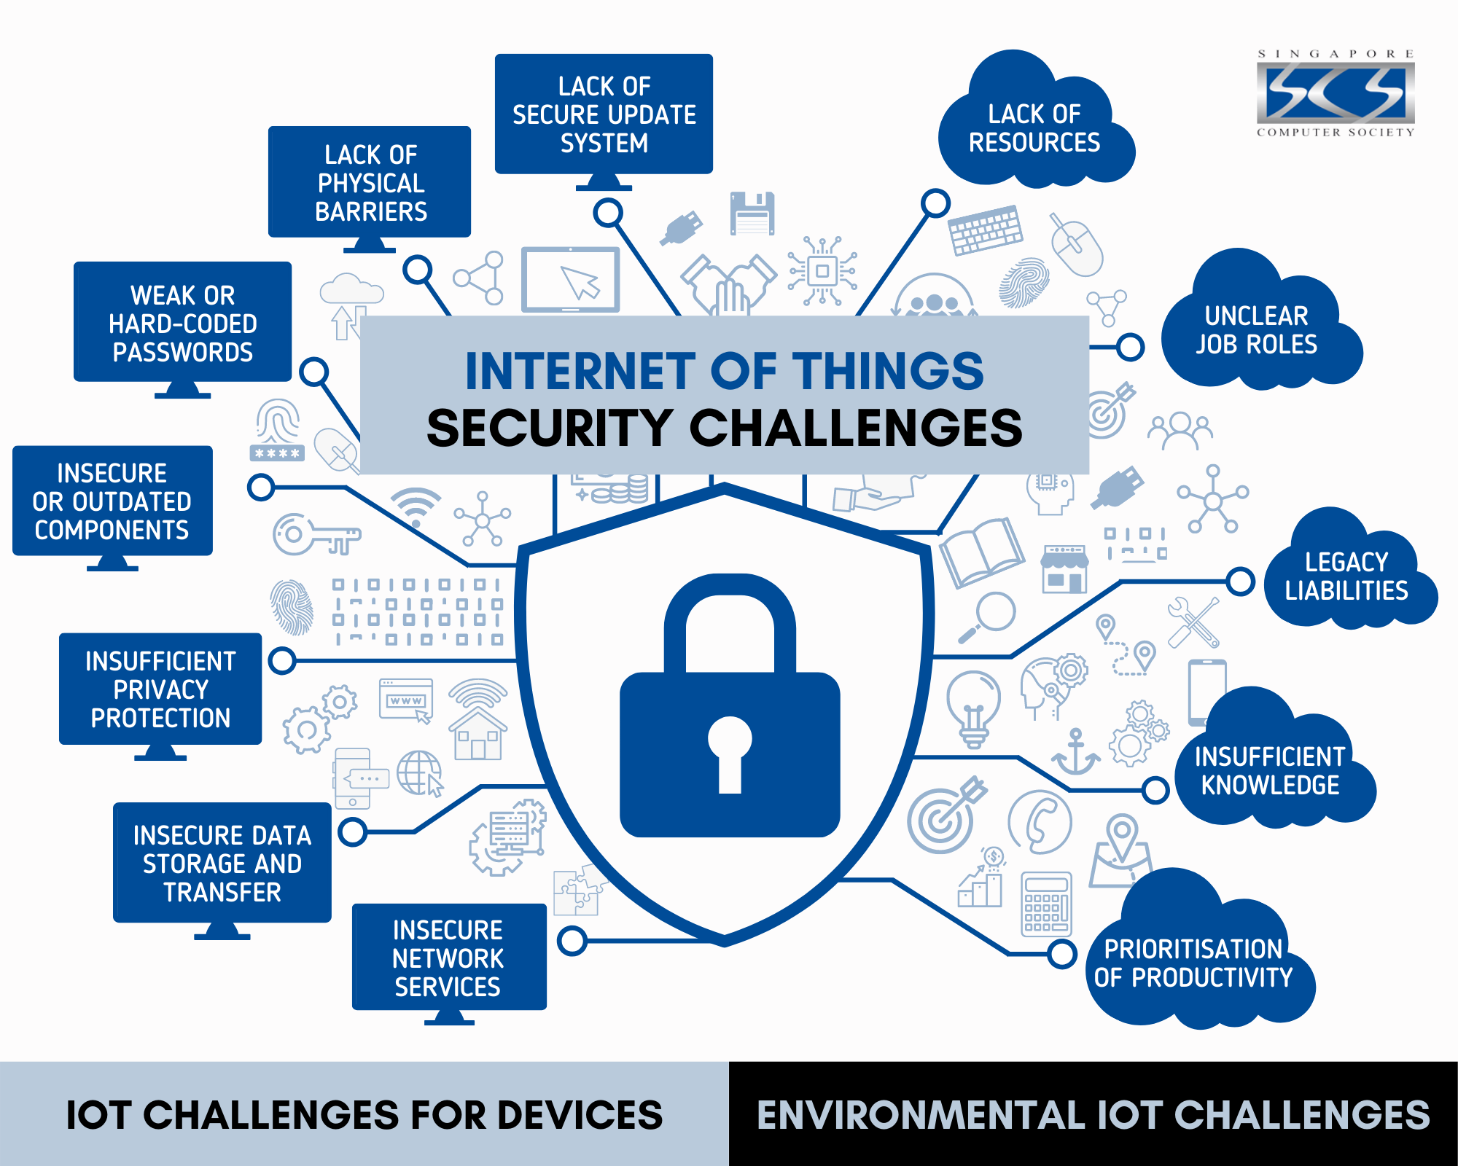
Internet of Things Security Issues

Slide 37
Solutions
Technology Solutions
Policy Solutions

Slide 38
Technology and Policy Solutions
Managing risk includes:
  Technology
  Effective management policies
  Public laws and active enforcement
Worldwide, in 2022, companies were expected to spend about $300 billion on security hardware, software, services.

Slide 39
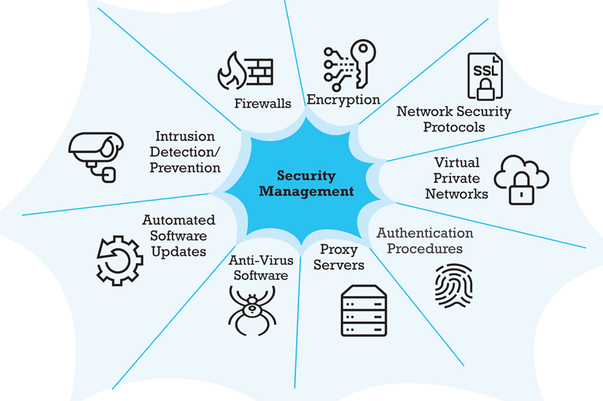
Technology Solutions
Protecting Internet communications
Securing channels of communication
Protecting networks
Protecting servers and clients

Slide 40


1. Protecting Internet Communications
Encryption
  Transforms data into cipher text readable only by sender and receiver
  Sender and receiver use same digital key to encrypt and decrypt message
  Requires different set of keys for each transaction
  Secures stored information and information transmission
Cryptography
  Symmetric Key Cryptography
    Sender and receiver use same digital key to encrypt and decrypt message
    Requires different set of keys for each transaction
  Asymmetric (Public Key) Cryptography
    Uses two mathematically related digital keys
      Public key (widely disseminated)
      Private key (kept secret by owner)
    Sender uses recipient’s public key to encrypt message; recipient uses private key to decrypt it

Slide 41

2. Securing Channels of Communication
Virtual Private Network (VPN)
  Allows remote users to securely access internal network via the Internet
Secure Sockets Layer (SSL)/Transport Layer Security (TLS)
  TLS establishes secure, negotiated client-server session
  Used in conjunction with HTTPS, secure version of HTTP
Wireless (Wi-Fi) networks
  WPA2 & WPA3
  (since 2020 WPA3 is need for a device to be
  Wi-Fi Certified)
Video on SSL/TLS

Slide 42
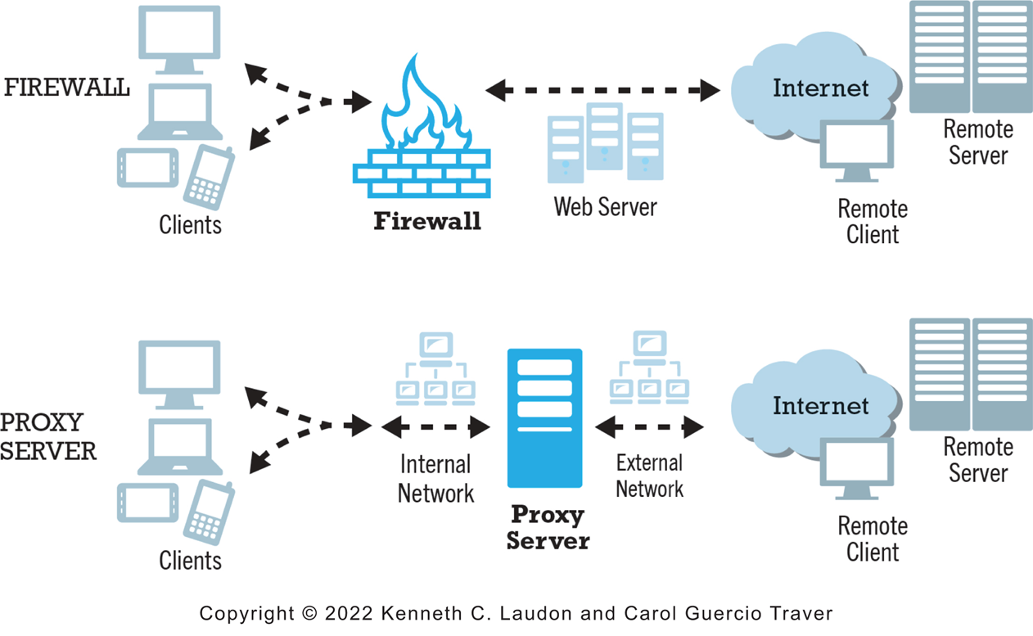
3. Protecting Networks
Firewall
The primary function of a firewall is to deny access by remote client computers to local computers.
Proxy Servers (proxies)
The primary purpose of a proxy server is to provide controlled access from local computers to remote computers
Figure 4.11 illustrates how firewalls and proxy servers protect a local area network from Internet intruders and prevent internal clients from reaching prohibited web servers.

Slide 43
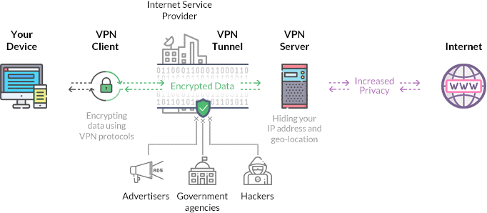
VPN Example

Slide 44

4. Protecting Servers and Clients
Upgrades, patches
  Operating system and application software security enhancements
Anti-virus software
  Easiest and least expensive way to prevent threats to system integrity
  Requires daily updates

Slide 45
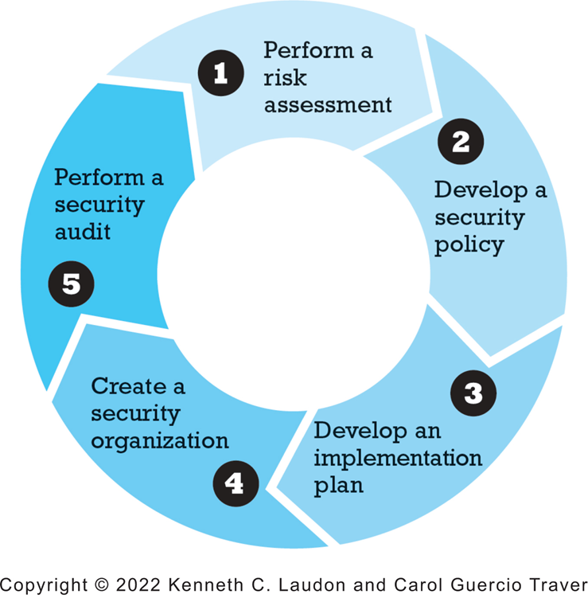
Policy Solutions
A Security Plan: Management Policies
Risk assessment
Security policy
Implementation plan
Security organization
  Access controls
  Authentication procedures, including biometrics
  Authorization policies, authorization management systems
Security audit
Figure 5.12 Developing an E-commerce Security Plan

Slide 46
The Role of Laws and Public Policy
Laws that give authorities tools for identifying, tracing, prosecuting cybercriminals:
  Data Protection: The GDPR 2016
  e-Privacy: The e-Privacy Regulations 2011
  Network and Information Systems: NIS Directive 2016
  Payment Services: PSD2 2015
Government policies and controls on encryption software
  OECD, G7/G8, Council of Europe, Wassener Arrangement

Slide 47
Privacy Protection in Europe
European privacy protection much stronger than in United States
1998 European Commission’s Directive on Data Protection
    Safe harbor
2016 E. U. General Data Protection Regulation (GDPR)
    Privacy Shield
Privacy environment has turned against U.S. firms like Facebook and unfettered collection and use of personal data

Slide 48
General Data Protection Regulation 2016
The GDPR places obligations on an organisation, and the staff within an organisation, to ensure personal data is processed fairly, lawfully and securely.
This means that personal data should only be processed if they have:
  a valid condition of processing (lawful purpose) and
  they have provided information to the individuals concerned about how and why they are processing their information (e.g. a privacy notice).
There are restrictions on what they are allowed to do with personal data such as passing personal information on to third parties, transferring information outside the EU or using it for direct marketing.

Slide 49
GDRP 2016 continued
Under GDPR failure to comply with data protection legislation can have very serious consequences.
Apart from damage to an organisation's reputation, substantial fines can apply by the Data Protection Commission.
In addition, an individual, i.e. a data subject, has the right to take legal actions against an organisation that fails to comply with GDPR.

Slide 50
The e-Privacy Regulations 2011
The ePrivacy Regulation sets out that interference with electronic communications between individuals is prohibited unless a listed exception is applicable.
It protects the confidentiality of electronic communications.
Includes rules on the use of:
  Cookie walls and opt-outs
  Unsolicited and direct marketing
More Information >>

Slide 51
Network and Information Security Directive 2016
The NIS directive aims to achieve a high common level of security of networks and information systems within the European Union.
It establishes security and notification requirements for Operators of Essential Services (OoES) such as banking and health and Digital Service Providers (DSP).
It creates a cooperation group to facilitate strategic cybersecurity cooperation
More Information >>

Slide 52
Payment Services Directive 2018
PSD2 is a piece of legislation designed to force providers of payment services to improve customer authentication processes and to also bring in new regulation around third-party involvement.
Introduced common EU rules for electronic payments such as credit transfers, direct debits, card payments, and mobile and online payments.
It was intended to make payments between EU countries as easy and secure as payments made within a country.
More Information >>

Slide 53
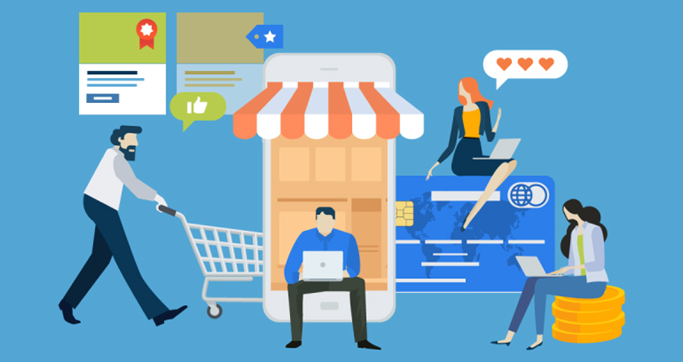

Chapter 5: E-commerce Security
Questions?

