Slide 1



E-commerce 2023: business. technology. society.
Chapter 2: E-Commerce Business Models and Concepts
Copyright © 2024, 2022, 2020 Pearson Education, Inc. All Rights Reserved
Notes:
If this PowerPoint presentation contains mathematical equations, you may need to check that your computer has the following installed:
1) MathType Plugin
2) Math Player (free versions available)
3) NVDA Reader (free versions available)

Slide 2
Learning Objectives
2.1 Identify the key components of e-commerce business models.
2.2 Describe the major B2C business models.
2.3 Describe the major B2B business models.
2.4 Understand key business concepts and strategies applicable to e-commerce.
Notes:
Slide 2 is list of textbook LO numbers and statements

Slide 3
Connected Cars: The Next Big
E-commerce Revolution?
Class Discussion
  How are new connected car technologies also creating new business models?
  What is the potential impact on different forms of e-commerce, such as the content industry?
  Why are tech companies so interested in the connected car platform?
  Are there any issues with respect to “connected” cars?

Slide 4
E-commerce Business Models
Business model
  Set of planned activities designed to result in a profit in a marketplace
Business plan
  Describes a firm’s business model
E-commerce business model
  Uses/leverages unique qualities of Internet and Web

Slide 5
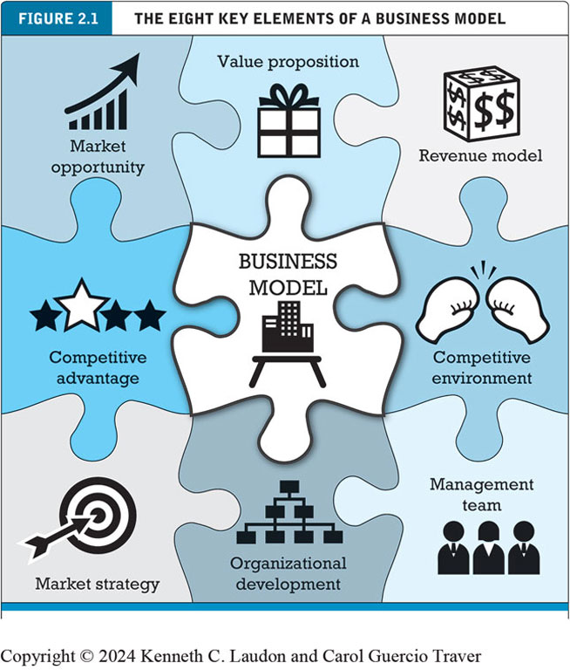
Eight Key Elements of a Business Model
Value proposition
Revenue model
Market opportunity
Competitive environment
Competitive advantage
Market strategy
Organizational development
Management team
Notes:
Figure 2.1, page 57.
A business model has eight key elements. Each element must be addressed if you hope to be successful.
Alt Text
Long description: The puzzle has 9 pieces. Each piece of the jigsaw puzzle has an icon and a title. In the middle, the piece has the title business model, and the icon is a table that has a building on it. Starting from the top left in a clockwise direction, the titles of the pieces are market opportunity, value proposition, revenue model, competitive environment, management team, organizational development, market strategy, and competitive advantage. The icons are as follows: a concave-up decreasing graph icon, a gift icon, a dollar dice icon, a boxing gloves icon, a three figures icon, a hierarchical graph icon, a bullseye icon, and a 4-star icon, respectively.

Slide 6
1. Value Proposition
Eight Key Elements of a Business Model
Defines how a company’s product or service fulfils the needs of customers
“Why should the customer buy from you?”
Successful e-commerce value propositions:
  Personalisation/customisation of product offerings
  Reduction of product search, price discovery costs
  Facilitation of transactions by managing product delivery
Amazon’s primary value propositions are unparalleled selection and convenience.
Notes:
Netflix's value proposition focuses on providing engaging and fun digital content conveniently
McDonald's value proposition centers around providing affordable, convenient, and consistent fast food to customers worldwide.
Airbnb's value proposition is to provide travelers with affordable and unique accommodations that offer a more local and authentic experience.

Slide 7
2. Revenue Model
Eight Key Elements of a Business Model
Describes how the firm will earn revenue, generate profits, and produce a superior return on invested capital.
“How will you earn money?”
Major types of revenue models:
  Advertising revenue model
  Subscription revenue model
    Freemium strategy
  Transaction fee revenue model
  Sales revenue model
  Affiliate revenue model

Slide 8
Insight on Society: Foursquare’s Evolving Business Model: Leveraging Your Location
Class Discussion
  Why has the shift in Foursquare’s business model been the key to success for Foursquare?
  What is your opinion of Foursquare’s characterization of itself as one of the “good guys” in the location data industry?
  How is Foursquare attempting to cope with a more privacy-conscious business environment?

Slide 9
3. Market Opportunity
Eight Key Elements of a Business Model
Refers to the company’s intended marketspace and the overall potential financial opportunities available to the firm in that marketspace
“What marketspace do you intend to serve and what is its size?”
  Marketspace: Area of actual or potential commercial value in which company intends to operate
  Realistic market opportunity: Defined by revenue potential in each market niche in which company hopes to compete
Market opportunity typically divided into smaller niches

Slide 10
4. Competitive Environment
Eight Key Elements of a Business Model
Refers to the other companies operating in the same marketspace selling similar products
“Who else occupies your intended marketspace?”
  Other companies selling similar products in the same marketspace
  Includes both direct and indirect competitors
Influenced by:
  Number and size of active competitors
  Each competitor’s market share
  Competitors’ profitability
  Competitors’ pricing

Slide 11
5. Competitive Advantage
Eight Key Elements of a Business Model
Achieved by a firm when it can produce a superior product and/or bring the product to market at a lower price than most, or all, of its competitors
“What special advantages does your firm bring to the marketspace?”
  Is your product superior to or cheaper to produce than your competitors’?
Important concepts:
  Asymmetries
  First-mover advantage, complementary resources
  Unfair competitive advantage
  Leverage
  Perfect markets

Slide 12
6. Market Strategy
Eight Key Elements of a Business Model
The plan you put together that details exactly how you intend to enter a new market and attract new customers
“How do you plan to promote your products or services to attract your target audience?”
  Details how a company intends to enter market and attract customers
  Best business concepts will fail if not properly marketed to potential customers

Slide 13
7. Organizational Development
Eight Key Elements of a Business Model
A plan that describes how the company will organize the work that needs to be accomplished
“What types of organizational structures within the firm are necessary to carry out the business plan?”
Describes how firm will organize work
  Typically, divided into functional departments
  As company grows, hiring moves from generalists to specialists

Slide 14
8. Management Team
Eight Key Elements of a Business Model
Senior employees of the company responsible for making the business model work
“What kind of backgrounds should the company’s leaders have?”
A strong management team:
  Can make the business model work
  Can give credibility to outside investors
  Has market-specific knowledge
  Has experience in implementing business plans

Slide 15
Raising Capital
Seed capital
Elevator pitch
Traditional sources
  Incubators, angel investors
  Commercial banks, venture capital firms
  Strategic partners
Equity crowdfunding
  J O B S Act

Slide 16
Insight on Business: Startups Turn to Crowdfunding
Class Discussion
  Would you feel comfortable investing in a startup that raises capital using equity crowdfunding? Why or why not?
  Why is it important to democratize access to capital?
  What obstacles are presented in the use of crowdfunding as a method to fund startups?

Slide 17
Categorising E-Commerce Business Models
No one correct way
Text categorizes according to:
  E-commerce sector (e.g., B2B)
  E-commerce technology (e.g., m-commerce)
Similar models appear in different sectors
Companies may use multiple business models (e.g., eBay)
E-commerce enablers

Slide 18
B2C Business Models
Online retailer (e-tailer)
Community provider (social network)
Content provider
Portal
Transaction broker
Market creator
Service provider

Slide 19
B2C Models: E-Tailer
Online version of traditional retailer
Revenue model: Sales
Variations:
  Virtual merchant
  Bricks-and-clicks
  Catalog merchant
  Manufacturer-direct
Low barriers to entry

Slide 20
B2C Models: Community Provider
Provide online environment (social network) where people with similar interests can transact, share content, and communicate
  Examples: Facebook, LinkedIn, Twitter, Pinterest
Revenue models:
  Typically use a hybrid model, combining advertising, subscriptions, sales, and transaction fees

Slide 21
B2C Models: Content Provider
Digital content on the Web:
  News, music, video, text, artwork
Revenue models:
  Use variety of models, including advertising, subscription; sales of digital goods
  Key to success is typically owning the content
User-generated content, creators, and the creator economy
  Playing an ever-increasing role in online content landscape

Slide 22
B2C Business Models: Portal
Search plus an integrated package of content and services
Revenue models:
  Advertising, referral fees, transaction fees, subscriptions for premium services
Variations:
  Horizontal/general: (examples: Yahoo, A O L, M S N)
  Vertical/specialized (vortal): (example: Sailnet)
  Search: (examples: Google, Bing)

Slide 23
B2C Models: Transaction Broker
Process online transactions for consumers
  Primary value proposition - saving time and money
Revenue model:
  Transaction fees
Industries using this model:
  Financial services
  Travel services

Slide 24
B2C Models: Market Creator
Create digital environment where buyers and sellers can meet and transact
  Examples: Priceline, eBay, Etsy
  Revenue model: Transaction fees, fees to merchants for access
On-demand service companies (sharing economy): platforms that allow people to sell services
  Examples: Uber, Airbnb

Slide 25
Insight on Technology: Behind the Scenes at Etsy
Class Discussion
  What are the technologies that Etsy uses to create an online platform for sellers and buyers?
  What issues did Etsy face creating its platform?
  Have you ever used Etsy as either a seller or buyer? What was your experience with the platform?
  What challenges does Etsy face in the future?

Slide 26
B2C Models: Service Provider
Online services
  Example: Google
    Google Maps, Gmail, and so on
Value proposition
  Valuable, convenient, time-saving, low-cost alternatives to traditional service providers
Revenue models:
  Sales of services, subscription fees, advertising, sales of marketing data

Slide 27
B2B Business Models
Net marketplaces
  E-distributor
  E-procurement
  Exchange
  Industry consortium
Private B2B networks

Slide 28
B2B Models: E-distributor
Version of retail and wholesale store, M R O goods, and indirect goods
Owned by one company seeking to serve many customers
Revenue model: Sales of goods
Example: Cisco Systems

Slide 29
B2B Models: E-procurement Companies
Creates digital markets where participants transact for indirect goods
  B2B service providers, S a a S and P a a S providers
  Scale economies
Revenue model: Service fees, supply-chain management, fulfillment services
Example: Google

Slide 30
B2B Models: Exchanges
Independently owned vertical digital marketplace for direct inputs
Revenue model: Transaction, commission fees
Create powerful competition between suppliers
Tend to force suppliers into powerful price competition; number of exchanges has dropped dramatically
Example: Go2Paper

Slide 31
B2B Models: Industry Consortia
Industry-owned vertical digital marketplace open to select suppliers
More successful than exchanges
  Sponsored by powerful industry players
  Strengthen traditional purchasing behavior
Revenue model: Transaction, commission fees
Example: SupplyOn

Slide 32
B2B Models: Private B2B Networks
Digital network used to coordinate among firms engaged in business together
Typically evolve out of large company’s internal enterprise system
  Key, trusted, long-term suppliers invited to network
Example: Walmart’s network for suppliers

Slide 33
How E-Commerce Changes Business
E-commerce changes industry structure by changing:
  Rivalry among existing competitors
  Barriers to entry
  Threat of new substitute products
  Strength of suppliers
  Bargaining power of buyers
Industry structural analysis

Slide 34
Industry Structural Analysis
Porters 5 Forces

Slide 35
Industry Value Chains
Set of activities performed by suppliers, manufacturers, transporters, distributors, and retailers that transform raw inputs into final products and services
Internet reduces cost of information and other transactional costs
Leads to greater operational efficiencies, lowering cost, prices, adding value for customers

Slide 36
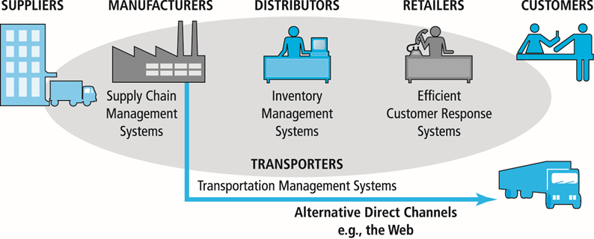
Figure 2.4 E-Commerce and Industry Value Chains
Notes:
Figure 2.4, Page 90.
Every industry can be characterized by a set of value-adding activities performed by a variety of actors. E-commerce potentially affects the capabilities of each player as well as the overall operational efficiency of the industry.
Long description: An illustration depicts industry value chains, as follows: The value chain begins with suppliers. Manufacturers use supply chain management systems. Distributors use inventory management systems. Retailers use efficient customer response systems. Customers are the last link in the chain. Manufacturers can use transporters with transportation management systems to move inventory directly to customers via alternative direct channels such as the web.

Slide 37
Firm Value Chains
Activities that a firm engages in to create final products from raw inputs
Each step adds value
Effect of Internet:
  Increases operational efficiency
  Enables product differentiation
  Enables precise coordination of steps in chain

Slide 38
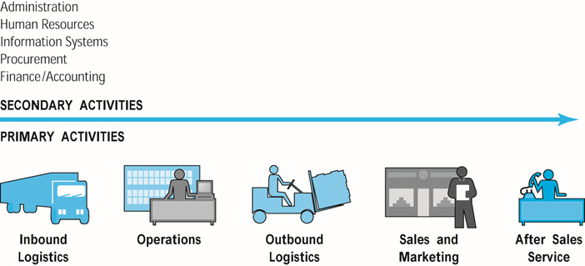
Figure 2.5 E-Commerce and Firm Value Chains
Notes:
Figure 2.5, page 90.
Every firm can be characterized by a set of value-adding primary and secondary activities performed by a variety of actors in the firm. A simple firm value chain performs five primary value-adding steps: inbound logistics, operations, outbound logistics, sales and marketing, and after sales service.
Alt Text
Long description: An illustration depicts firm value chains, as follows: Primary activities in a firm value chain include inbound logistics, operations, outbound logistics, sales and marketing, and after sales service. Secondary activities include administration, human resources, information systems, procurement, and finance and accounting.

Slide 39
Firm Value Webs
Networked business ecosystem
Uses Internet technology to coordinate the value chains of business partners
Coordinates a firm’s suppliers with its own production needs using an Internet-based supply chain management system
Example: Amazon – DHL, An Post etc

Slide 40
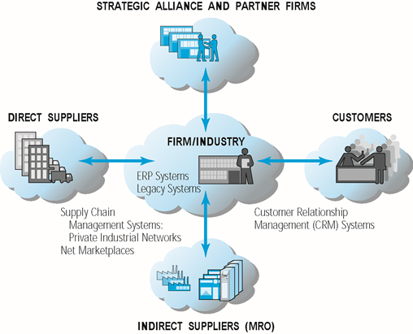
Figure 2.6 Internet-Enabled Value Web
Notes:
Figure 2.6, page 91.
Internet technology enables firms to create an enhanced value web in cooperation with their strategic alliance and partner firms, customers, and direct and indirect suppliers.
Alt Text
Long description: An illustration depicts an internet enabled value web, as follows: In a value web, a firm or industry uses e commerce technology to coordinate with strategic alliance and partner firms, customers through customer relationship management or C R M systems, and indirect suppliers or M R O and direct suppliers through E R P systems and legacy systems and supply chain management systems, private industrial networks and net marketplaces.

Slide 41
Business Strategy
Plan for achieving superior long-term returns on capital invested: that is, profit
Five generic strategies
  Product/service differentiation
  Cost competition
  Scope (market and products)
  Focus/market niche
  Customer intimacy

Slide 42
E-Commerce Technology and Business Model Disruption
Disruptive technologies
Digital disruption
Sustaining technology
Stages
  Disruptors introduce new products of lower quality
  Disruptors improve products
  New products become superior to existing products
  Incumbent companies lose market share

Slide 43
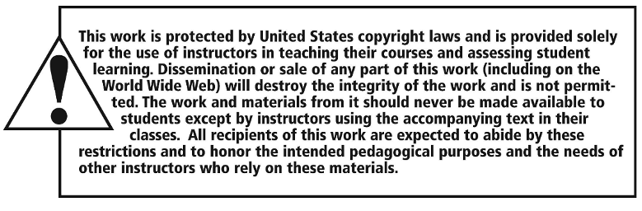
Copyright

