Slide 1




Introduction to E-commerce - Chapter 1
The Revolution Is Just Beginning
E-commerce 2018: business. technology. society
Fourteenth Edition
E-commerce 2021–2022: business. technology. society.
Seventeenth Edition, Global Edition
E-commerce 2023: business. technology. society.
Seventeenth Edition
Copyright © 2022, 2019, 2018 Pearson Education, Ltd. All Rights Reserved
Notes:
If this PowerPoint presentation contains mathematical equations, you may need to check that your computer has the following installed:
1) MathType Plugin
2) Math Player (free versions available)
3) NVDA Reader (free versions available)

Slide 2
Learning Objectives
1.1 Understand why it is important to study e-commerce.
1.2 Define e-commerce, understand how e-commerce differs from e-business, identify the primary technological building blocks underlying e-commerce, and recognise major current themes in e-commerce.
1.3 Identify and describe the unique features of e-commerce technology and discuss their business significance.
1.4 Describe the major types of e-commerce.
1.5 Understand the evolution of e-commerce from its early years to today.
1.6 Describe the major themes underlying the study of e-commerce.

Slide 3
TikTok: Creators and the Creator Economy
Class Discussion
  Why is TikTok so popular?
  Do you use TikTok? If so, in what manner - do you just view content or also post content?
  Do you consider yourself a creator? Have you ever received payments for content you have created?
  What are some of the negative consequences associated with being a creator?

Slide 4
The First Five Minutes: Why You Should Study E-commerce
First quarter-century or so of e-commerce
  Still just the beginning
  Rapid growth and change
Technologies evolve at exponential rates
  Disruptive business change
  New opportunities
Why study e-commerce
  Understand opportunities and risks
  Analyze e-commerce ideas, models, issues

Slide 5
Introduction to E-commerce
Use of Internet to transact business
  Includes Web, mobile browsers and apps
More formally:
  Digitally enabled commercial transactions between and among organizations and individuals

Slide 6
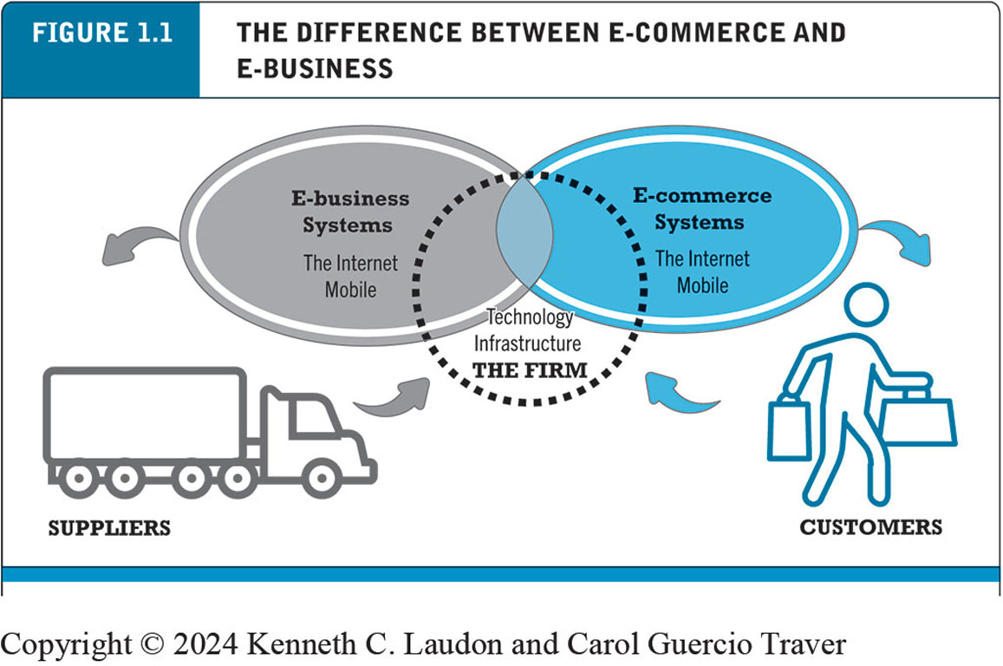
E-commerce v E-business
The difference between E-commerce and E-business
E-business:
  Digital enabling of transactions and processes within a firm, involving information systems under firm’s control
  Does not include commercial transactions involving an exchange of value across organisational boundaries
E-commerce
  Primarily involves transactions that cross firm boundaries

Slide 7
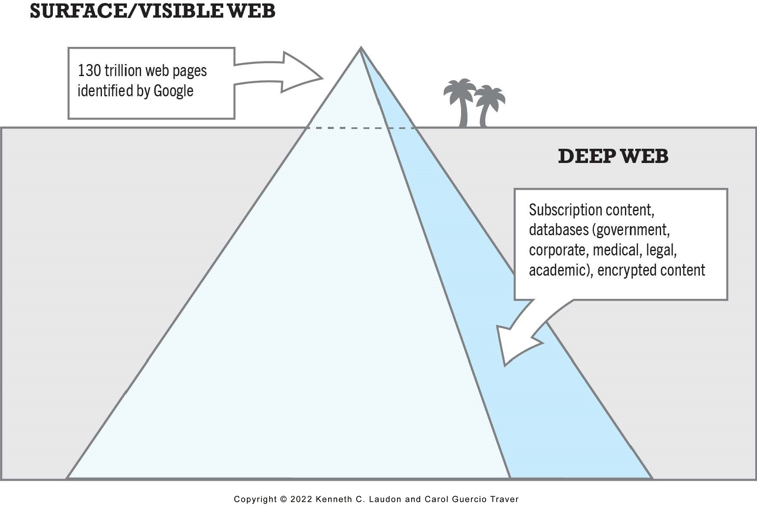
Technological Building Blocks Underlying E-commerce
Internet
  Worldwide network of computer networks built on common standards
World Wide Web
  H T M L
  Deep Web versus “surface” Web
Mobile platform
  Smartphones, tablets, ultra-lightweight laptops
  Mobile apps

Slide 8
Insight on Technology: Will Apps Make the Web Irrelevant?
Group Discussion
What are the advantages and disadvantages of apps, compared with websites, for mobile users?
What are the benefits of apps for content owners and creators?
What are progressive web apps (P W A s) and how do they differ from native apps?
Will apps eventually make the Web irrelevant? Why or why not?

Slide 9
Major Trends in E-commerce (1 of 3)
Business trends include:
  Retail e-commerce and m-commerce settle back to normal growth rates (around 10%) after Covid-19 pandemic
  Mobile app ecosystem: almost 250 million U.S. adults use smartphone apps
  Social e-commerce estimated to generate around $55 billion in 2022
  B2B e-commerce revenues expected to reach about $8.5 trillion in 2022

Slide 10
Major Trends in E-commerce (2 of 3)
Technology trends include:
  Mobile platform
  Cloud computing
  Internet of Things
  Big data
  Artificial intelligence technologies
  Blockchain
  Web3
  Metaverse

Slide 11
Major Trends in E-commerce (3 of 3)
Societal trends include:
  User-generated content
  Commercial and governmental invasion of privacy
  Concerns about increasing market dominance of Amazon, Google, Meta (Big Tech)
  Online security issues

Slide 12

Major Trends in E-commerce
https://elearning-ta.tudublin.ie/mod/url/view.php?id=531489

Slide 13
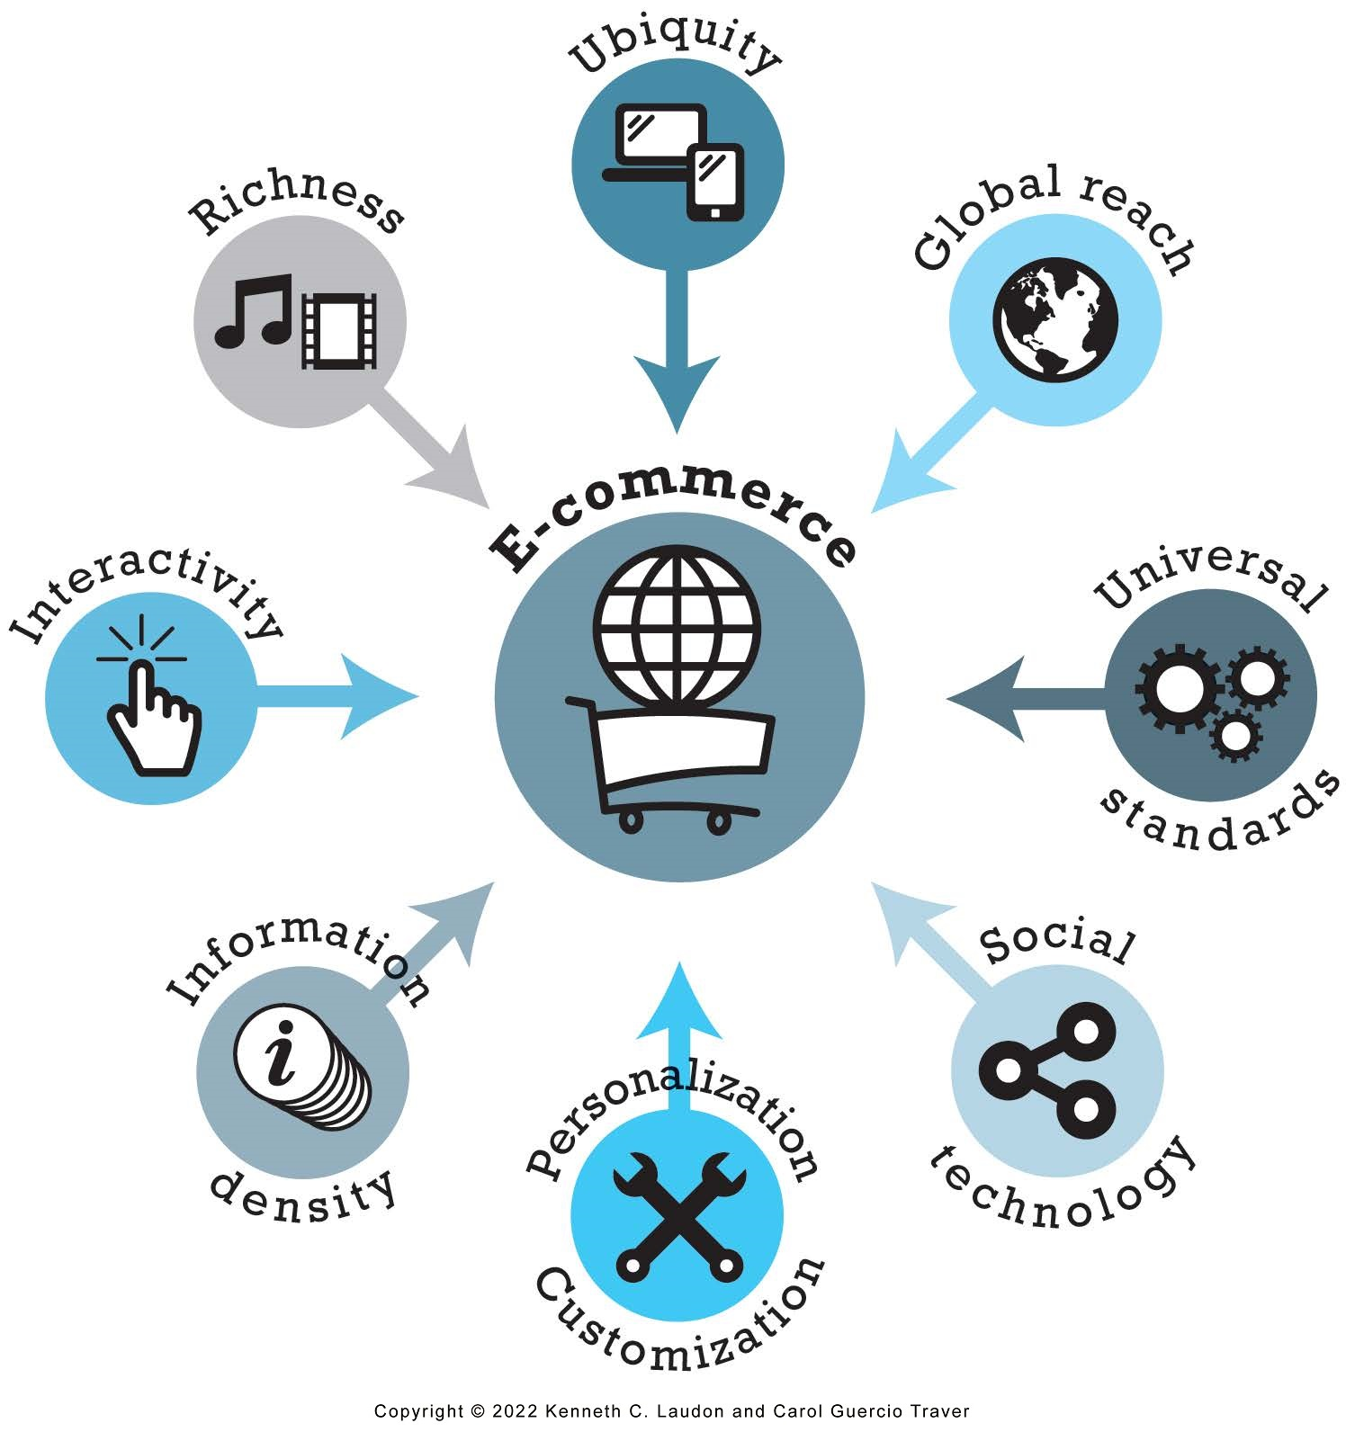
Unique Features of E-commerce Technology (1 of 2)
Ubiquity
Global reach
Universal standards
Information richness
- everywhere
- marketplace > marketspace
- Equalizes the playing field
- video ads, audio messages, and interactive text options
Notes:
1. Ubiquity is defined as being something that occurs everywhere. The great thing about the internet is that pretty much everyone, everywhere, can access it.
2. Global Reach refers to the previously brick and mortar stores, pre-internet, turning outward and morphing into an online “marketspace”. Global reach allows previously unheard of retailers to sell to the other side of the world, while it also connects the bigger sellers with new opportunities as well.
3. Universal Standards, the internet has its own universally accepted standards of presenting information. Equalizes the playing field for many businesses
4. Information Richness - video ads, audio messages, and interactive text options, on many retail sites. Facebook ads - tailor the ads

Slide 14
Unique Features of E-commerce Technology (2 of 2)
Interactivity
Information density
Personalization/customization
Social technology
- Online agents/chatbots and Customers are better able to give feedback
- availability of information
- target marketing
- changing the delivered product or service based on a user’s preferences or prior behaviour
- social media platforms: data collection and sales
Notes:
5. Interactivity. Online agents/chatbots and Customers are better able to give feedback on products.
6. Information Denseness refers to the availability of information. Business owner pricing their products.
7. Personalization/Customisation. The targeting of marketing messages to specific individuals by adjusting the message to their behaviour. Changing the delivered product or service based on a user’s preferences or prior behaviour
8. Social Technology. Sites like Facebook, Twitter, LinkedIn, Pinterest, Instagram, and so on, are not merely there for your entertainment. They all collect information about you and as I mentioned above, show you the kinds of ads and sites you would most likely be interested in based on that information. It has allowed worldwide networking

Slide 15
Types of E-commerce
Business-to-Consumer (B2C)
Business-to-Business (B2B)
Consumer-to-Consumer (C2C)
Mobile e-commerce (M-commerce)
Social e-commerce
Local e-commerce

Slide 16
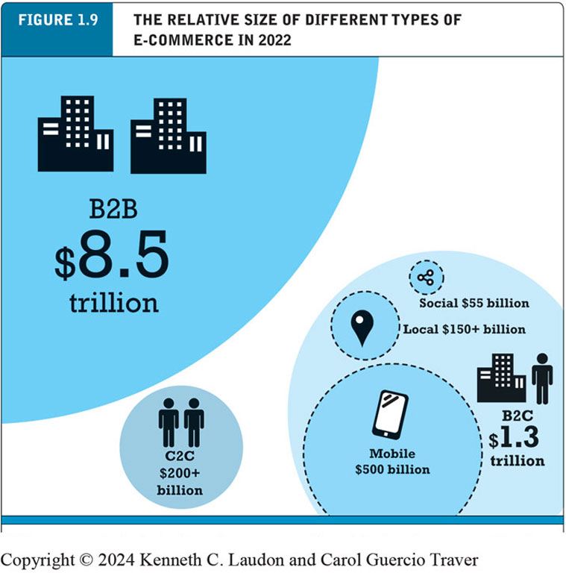
Figure 1.9 The Relative Size of Different Types of E-commerce
Notes:
Figure 1.9, Page 26.
B2B e-commerce dwarfs all other forms of e-commerce; mobile, social, and local e-commerce, although growing rapidly, are still relatively small in comparison to “traditional” e-commerce.
Alt Text
Long description: The data in the illustration is as follows: B 2 B e-commerce revenue, 8.5 trillion dollars; B 2 C e-commerce revenue, 1.3 trillion dollars. Within B 2 C e-commerce revenue, mobile e-commerce revenue is 500 billion dollars, social e-commerce revenue is 55 billion dollars, and local e-commerce revenue is more than 150 billion dollars. C 2 C e-commerce revenue is more than 200 billion dollars.

Slide 17
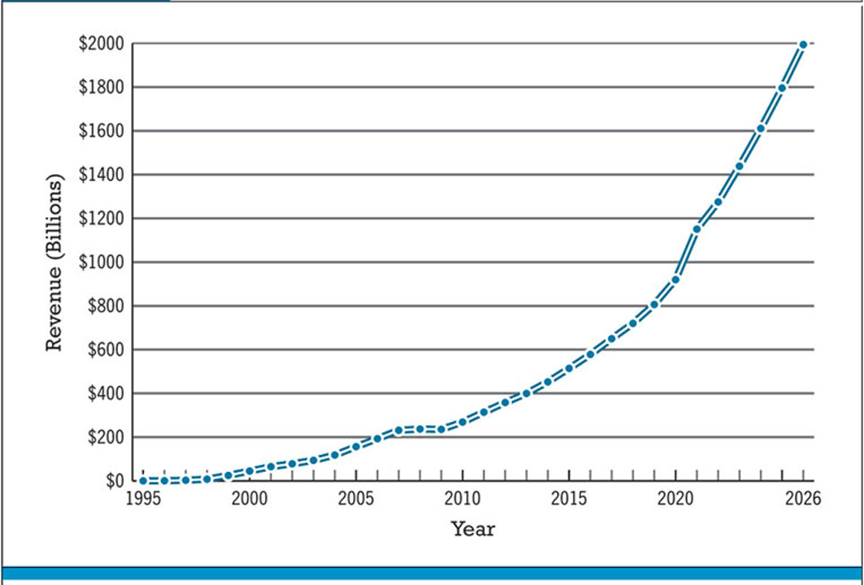
Figure 1.5 The Growth of B2C E-commerce in the United States
Notes:
Figure 1.5, Page 22.
In the early years, B2C e-commerce was doubling or tripling each year. Although B2C e-commerce growth in the United States slowed in 2008–2009 due to the economic recession, it resumed growing at about 13% in 2010 and since then, has continued to grow at double-digit rates. In 2020, revenues from B2C e-commerce are expected to reach $1.16 trillion. While the Covid-19 pandemic is anticipated to result in a dramatic decrease in the amount of digital travel revenues in 2020, both retail e-commerce revenues and certain online services, as well as online content revenues, are expected to be stable or increase, offsetting the decline.
SOURCES: Based on data from eMarketer, Inc., 2020f, 2020g; U.S. Census Bureau, 2019a; authors’ estimates.
Alt Text
Long description: A graph shows the growth of B 2 C e commerce revenue in the United States in billions of dollars from 19 95 to 20 24, as follows: The graph shows B 2 C e commerce revenue rising steadily from around 50 billion dollars in 2000 to a projected 1800 billion dollars in 20 24. All values are estimated.

Slide 18
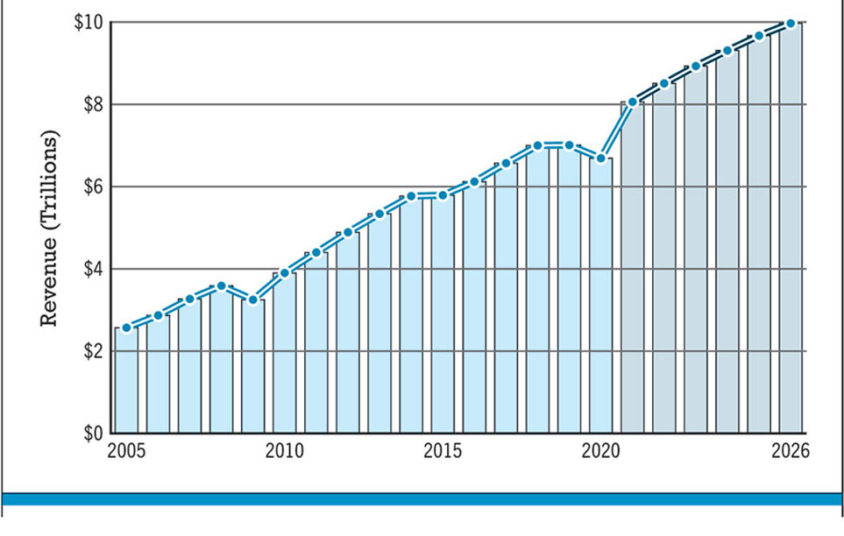
Figure 1.7 The Growth of B2B E-commerce in the United States
Notes:
Figure 1.7, Page 24.
B2B e-commerce in the United States is over six times the size of B2C e-commerce. In 2024, B2B e-commerce is projected to be reach around $9.8 trillion. (Note: Estimates for 2020 through 2024 may be impacted by the Covid-19 pandemic.)
SOURCES: Based on data from eMarketer, Inc., 2020i; U.S. Census Bureau, 2019b; authors’ estimates.
Alt Text
Long description: A graph shows the growth of B 2 B e commerce revenue in the United States in trillions of dollars from 2005 to 20 24, as follows: The graph shows B 2 B e-commerce revenue rising steadily from about 2.5 trillion dollars in 2005 to a projected 9.8 trillion dollars in 20 24. All values are estimated.

Slide 19
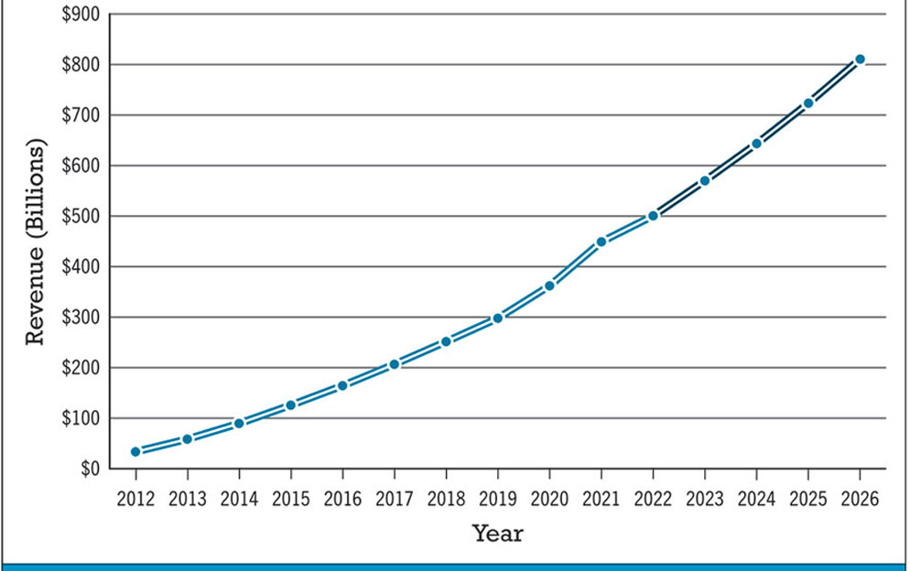
Figure 1.8 The Growth of M-commerce in the United States
Notes:
Figure 1.8, page 25.
M-commerce has increased astronomically, from just $32.8 billion in 2012 to an estimated $360 billion in 2020.
SOURCE: Based on data from eMarketer, Inc., 2020g, 2020h.
Alt Text
Long description: A graph shows the growth of m commerce revenue in billions of dollars from 20 12 to 20 24, as follows: The graph show m commerce revenue rising steadily from about 25 billion dollars in 20 12 to a projected 675 billion dollars in 20 24. All values are estimated.

Slide 20
E-commerce: A Brief History (1 of 4)
Precursors
  Baxter Healthcare modem-based system (1970s)
  Order entry systems (1980s)
  Electronic Data Interchange (E D I) standards (1980s)
  French Minitel (1981)

Slide 21
E-commerce: A Brief History (2 of 4)
1995–2000: Invention
  Sale of simple retail goods
  Limited bandwidth and media
  Euphoric visions of
    Friction-free commerce
    First-mover advantages
  Dot-com crash of 2000
Notes:
Additional concepts: disintermediation, monopoly profits, switching costs, network effects, disruption of traditional channels.

Slide 22
E-commerce: A Brief History (3 of 4)
2001–2006: Consolidation
  Emphasis on business-driven approach
  Traditional large firms expand presence
  Start-up financing shrinks
  More complex products and services sold
  Growth of search engine advertising
  Business web presences expand

Slide 23
E-commerce: A Brief History (4 of 4)
2007–Present: Reinvention
  Rapid growth of:
    Web 2.0, including online social networks
    Mobile platform
    Local commerce
    On-demand service economy
  Entertainment content develops as source of revenues
  Transformation of marketing

Slide 24
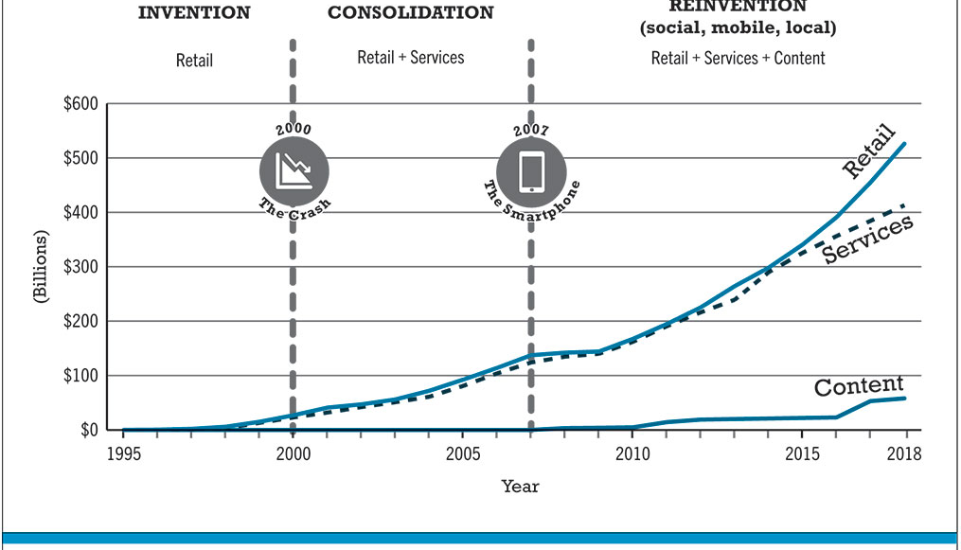
Figure 1.10 Periods in the Development of E-commerce
Notes:
Figure 1.10, page 28.
Alt Text
Long description: A graph illustrates phases of the development of e commerce in terms of billions of dollars of revenue for retail, services, and content, from 19 95 to 20 18, as follows: The three phases are Invention, Consolidation and Reinvention. During the period of Invention, from 19 95 to 2000, the curve for content revenue remains at 0, and retail and service revenue rise slightly from 0 in 19 98 to 25 billion dollars in 2000. The economic crash occurred in the U S in 2000. During the period of Consolidation from 2001 to 2007, the curve for retail and services revenues increases from 25 billion dollars in 2001 to 140 billion in 2007. The smartphone was invented in 2007. During the period of Reinvention, during which social, mobile, and local e commerce emerged, from 2008 to 20 18, the curve for retail revenue rises to 530 billion dollars in 20 18. Services revenue rises to 400 billion dollars in 20 18. Content revenue grows to 50 billion dollars by 20 18. All values are estimated.

Slide 25
Assessing E-commerce (1 of 2)
Stunning technological success
Early years a mixed business success
  Few early dot-coms have survived
  Online sales growing rapidly
Many early visions not fulfilled
  Price dispersion: variation in prices across sellers of the same item
  Information asymmetry: one party to an economic transaction has more or better information than the other party
  New intermediaries

Slide 26
Assessing E-commerce (2 of 2)
Other surprises
  Fast-follower advantages
  Start-up costs
  Impact of mobile platform
  Emergence of on-demand e-commerce

Slide 27
Understanding E-commerce: Organizing Themes
Technology:
  Development and mastery of digital computing and communications technology
Business:
  New technologies present businesses with new ways of organizing production and transacting business
Society:
  Intellectual property, individual privacy, public welfare policy

Slide 28
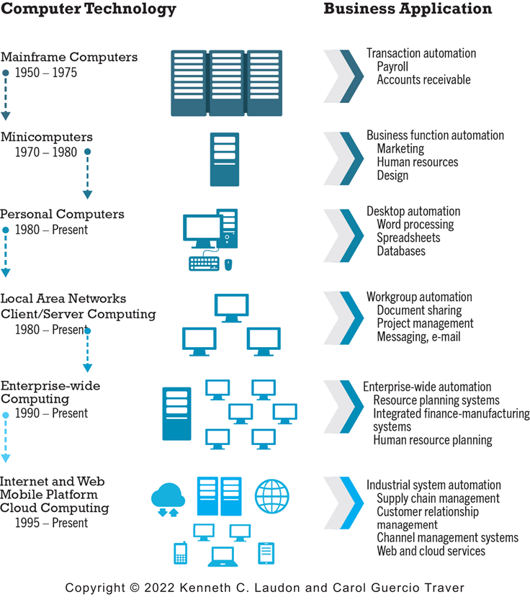
Figure 1.11 The Internet and the Evolution of Corporate Computing
Notes:
Figure 1.11, page 38.
The Internet and Web, and the emergence of a mobile platform held together by the Internet cloud, are the latest in a chain of evolving technologies and related business applications, each of which builds on its predecessors.
Alt Text
Long description: An illustration describes the evolution of corporate computing in the form of a timeline of advancements in computer technology and the corresponding business applications, as follows: Mainframe computer, 19 50 to 19 75. Applications, transaction automation, payroll, accounts payable. Minicomputers, 19 70 to 19 80. Applications, business function automation, marketing, human resources, and design. Personal computers, 19 80 to present. Applications: desktop automation, word processing, spread sheets, databases. Local area networks, client server computing, 19 80 to present. Applications, workgroup automation, document sharing, project management, messaging, email. Enterprise wide computing, 19 90 to present. Applications, enterprise wide automation, resource planning systems, integrated finance manufacturing systems, human resource planning. Internet and web mobile platform, cloud computing, 19 95 to present. Applications, industrial system automation, supply chain management, customer relationship management, channel management systems, web and cloud services.

Slide 29

Copyright
This work is protected by United States copyright laws and is provided solely for the use of instructors in teaching their courses and assessing student learning. Dissemination or sale of any part of this work (including on the World Wide Web) will destroy the integrity of the work and is not permitted. The work and materials from it should never be made available to students except by instructors using the accompanying text in their classes. All recipients of this work are expected to abide by these restrictions and to honor the intended pedagogical purposes and the needs of other instructors who rely on these materials.

